Slide 1

Software Development Portfolio
Showcasing two key projects demonstrating full-stack development and DevOps expertise
- Tanusha Hande

Slide 2
Project Overview
Project 1
Project 2
Course Management System
Spring Boot DevOps Pipeline
Python-based CRUD application with SQLite database for educational administration
Complete CI/CD implementation with GitHub, Jenkins, and Docker containerization
Both projects demonstrate practical software engineering skills and modern development practices.

Slide 3
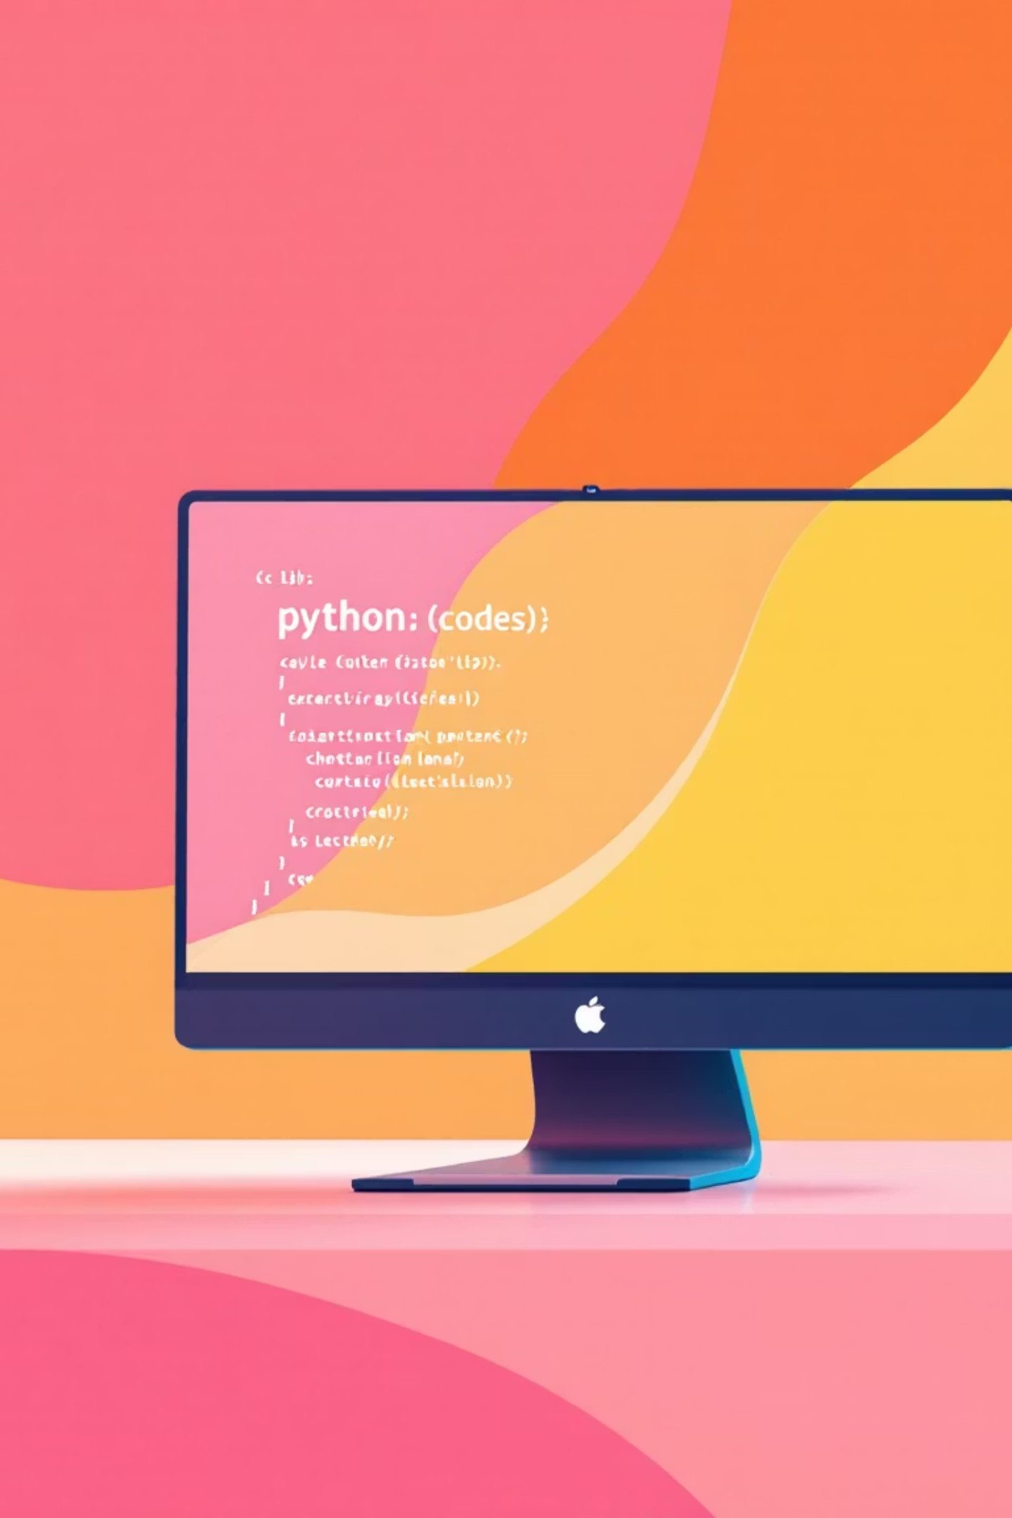
Course Management System
Objective
Develop a comprehensive system for managing educational courses with full CRUD functionality, providing administrators with tools to efficiently handle course data.

Slide 4

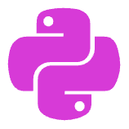

Course Management System Features
Database Operations
Python Implementation
User-Friendly Interface
Complete CRUD functionality using SQLite for reliable data persistence and retrieval of course information.
Clean, efficient Python code structure with proper error handling and data validation mechanisms.
Intuitive interface design allowing easy navigation through course creation, editing, and management functions.

Slide 5
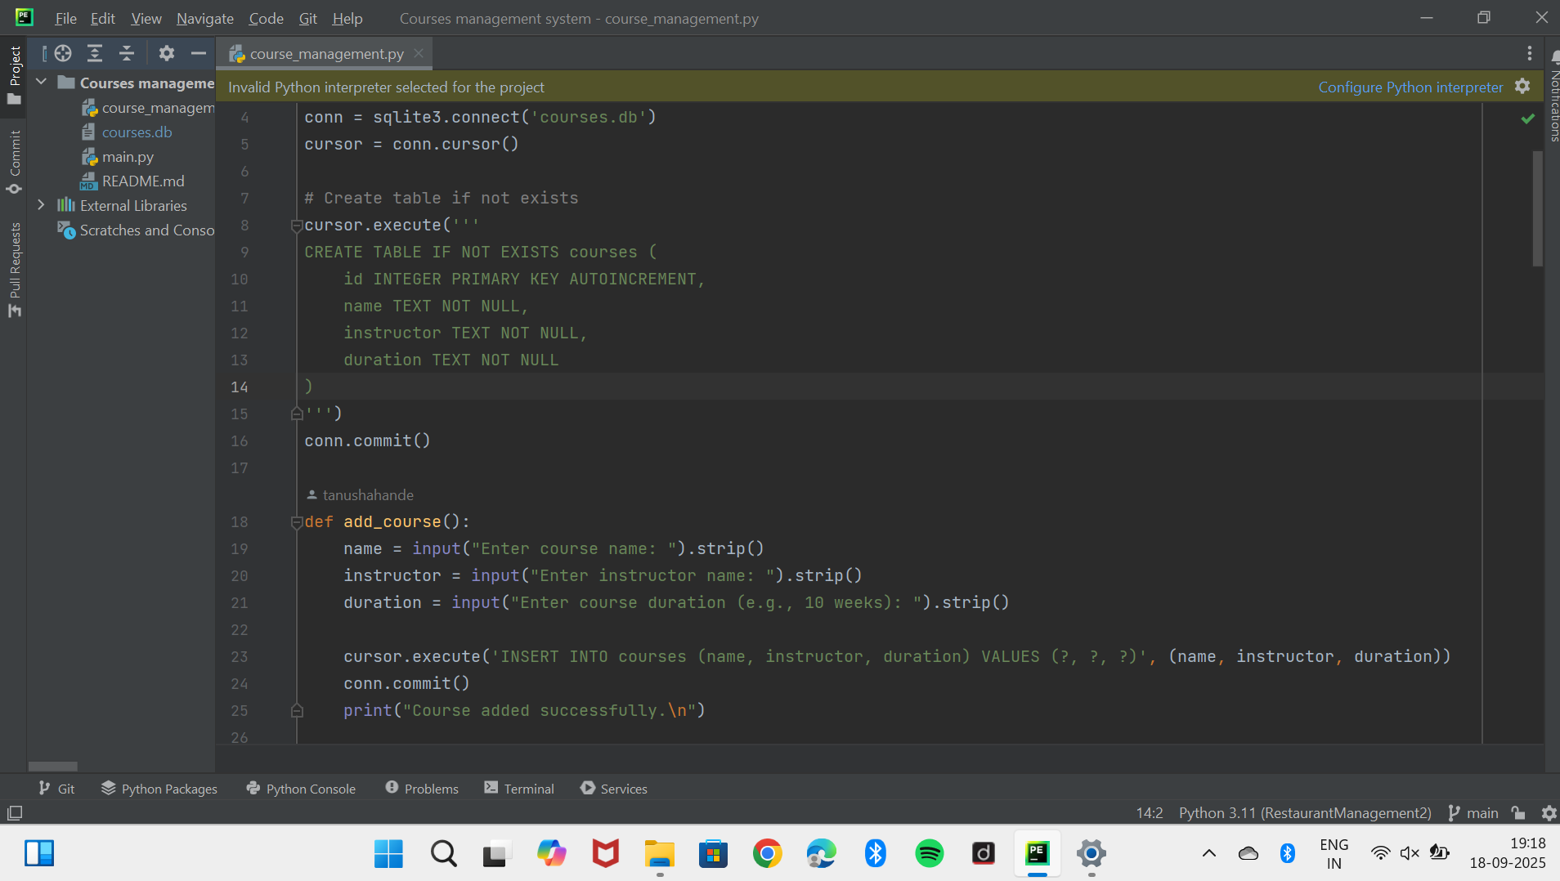
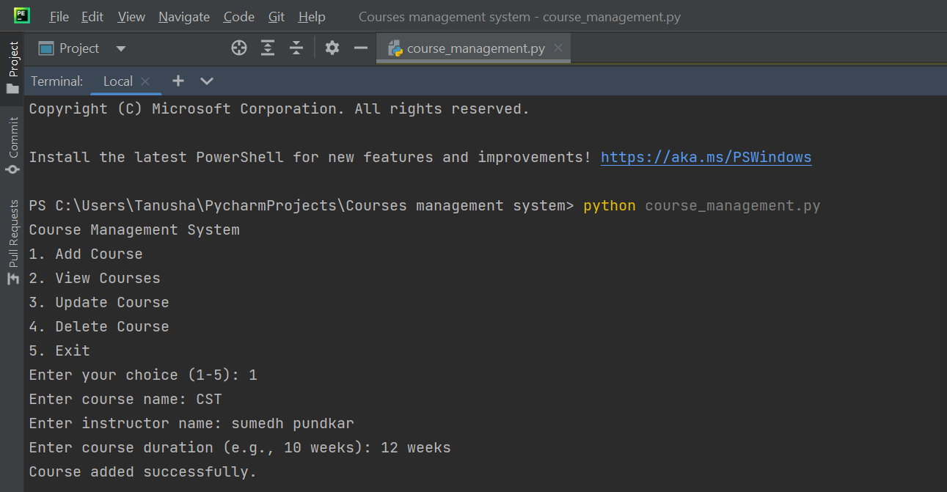
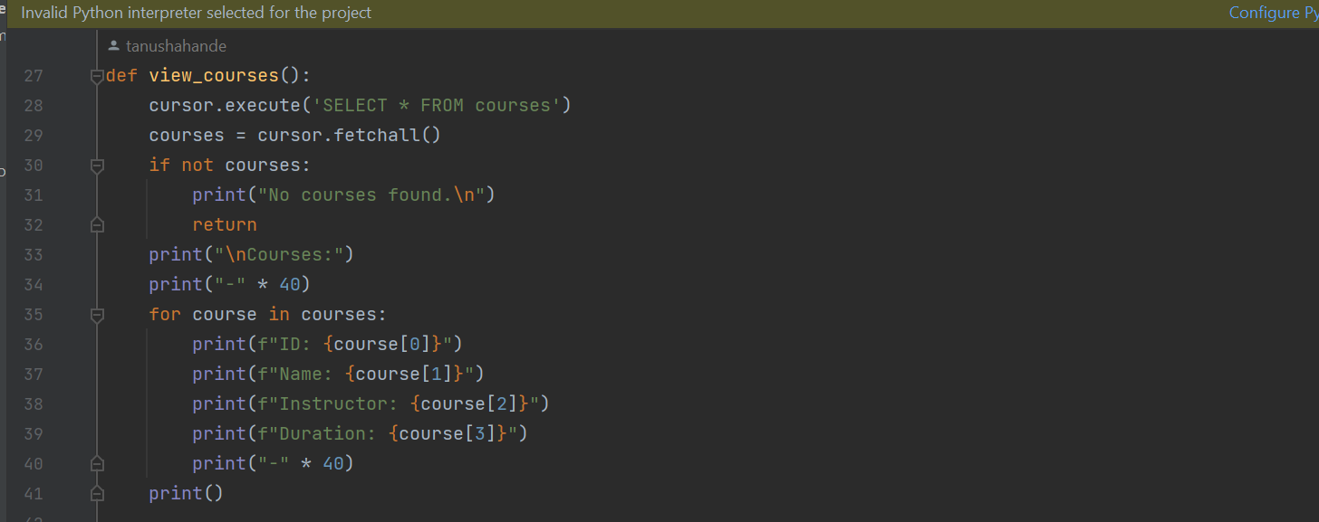
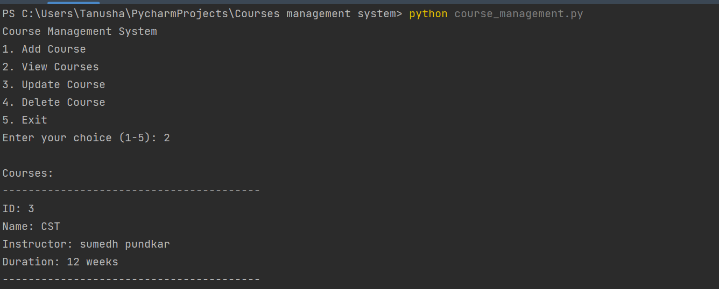

Slide 6
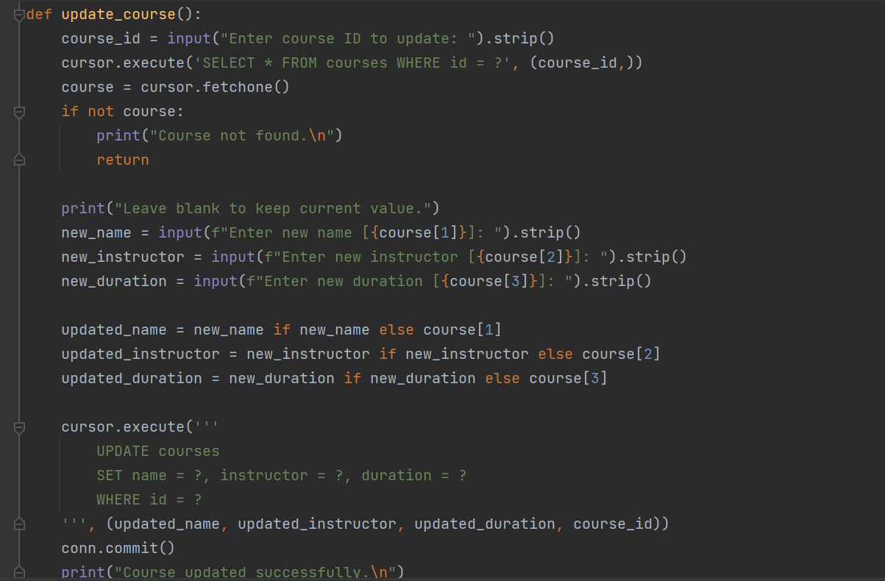
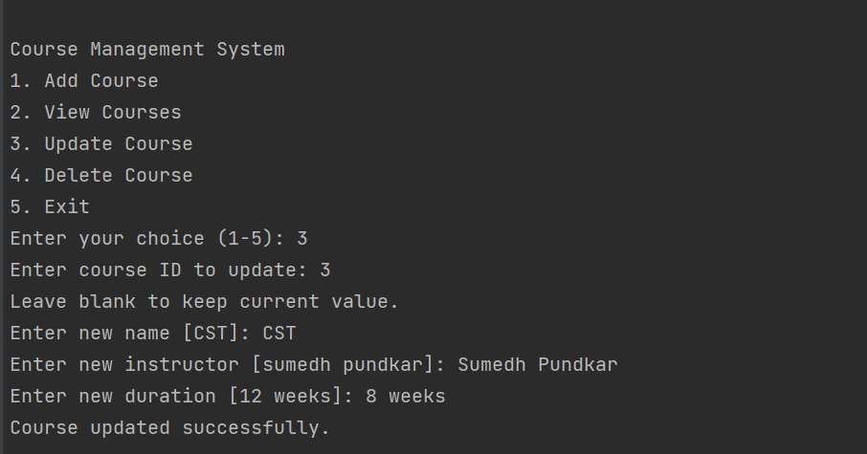
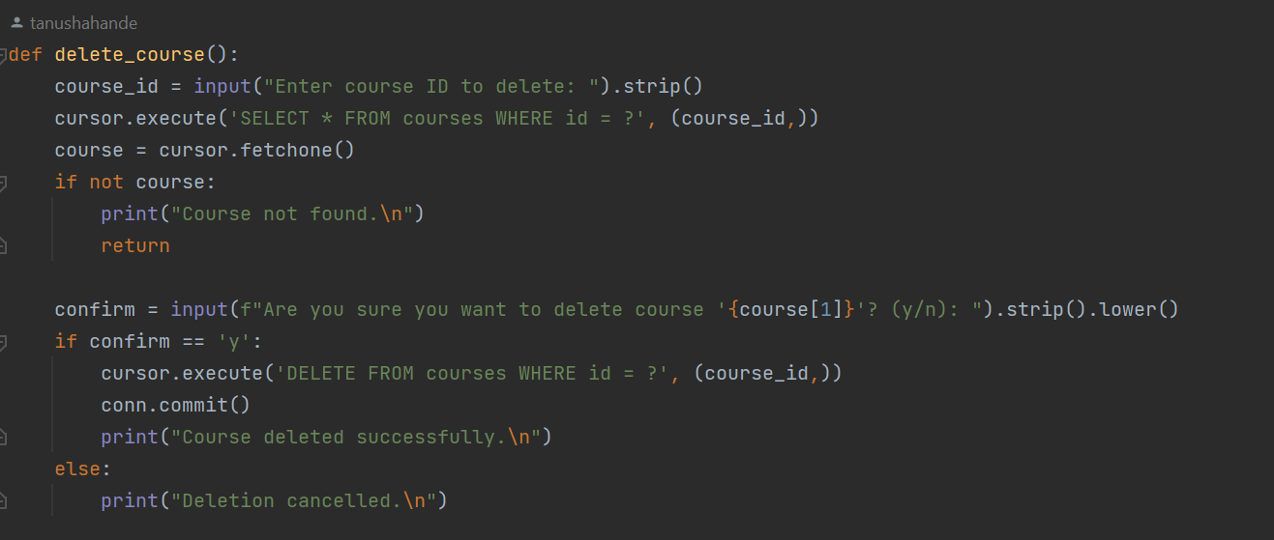
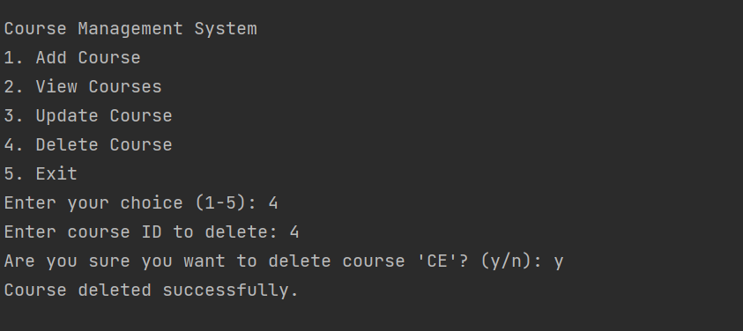

Slide 7
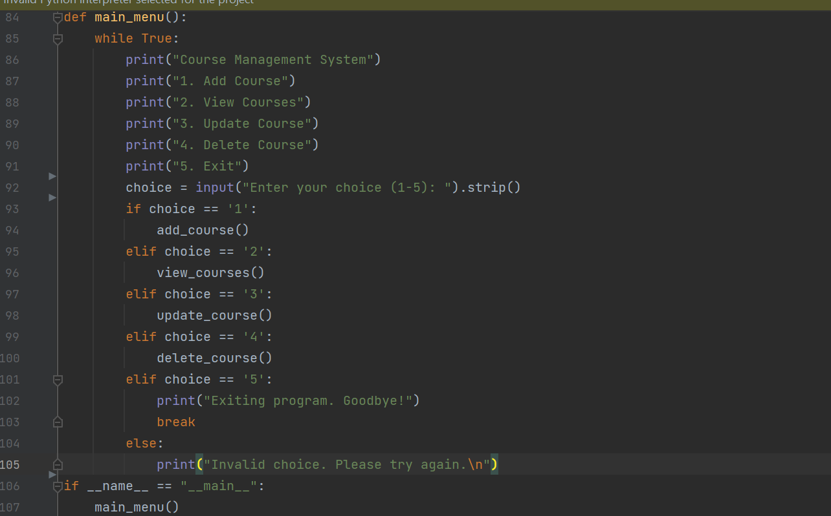
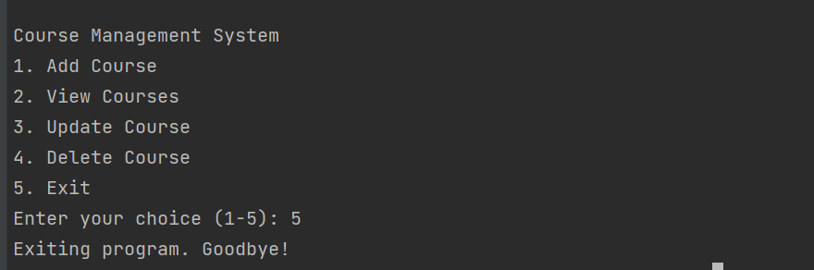

Slide 8

Spring Boot DevOps Project
Objective
Build a modern DevOps pipeline showcasing continuous integration and deployment practices using industry-standard tools and containerization technologies.

Slide 9




DevOps Pipeline Architecture
Spring Boot Development
Version Control
Created robust Java application with Spring Boot framework
Pushed code to GitHub repository with proper branching strategy
CI/CD Integration
Containerization
Connected Jenkins for automated build and deployment processes
Dockerized application for consistent deployment across environments

Slide 10
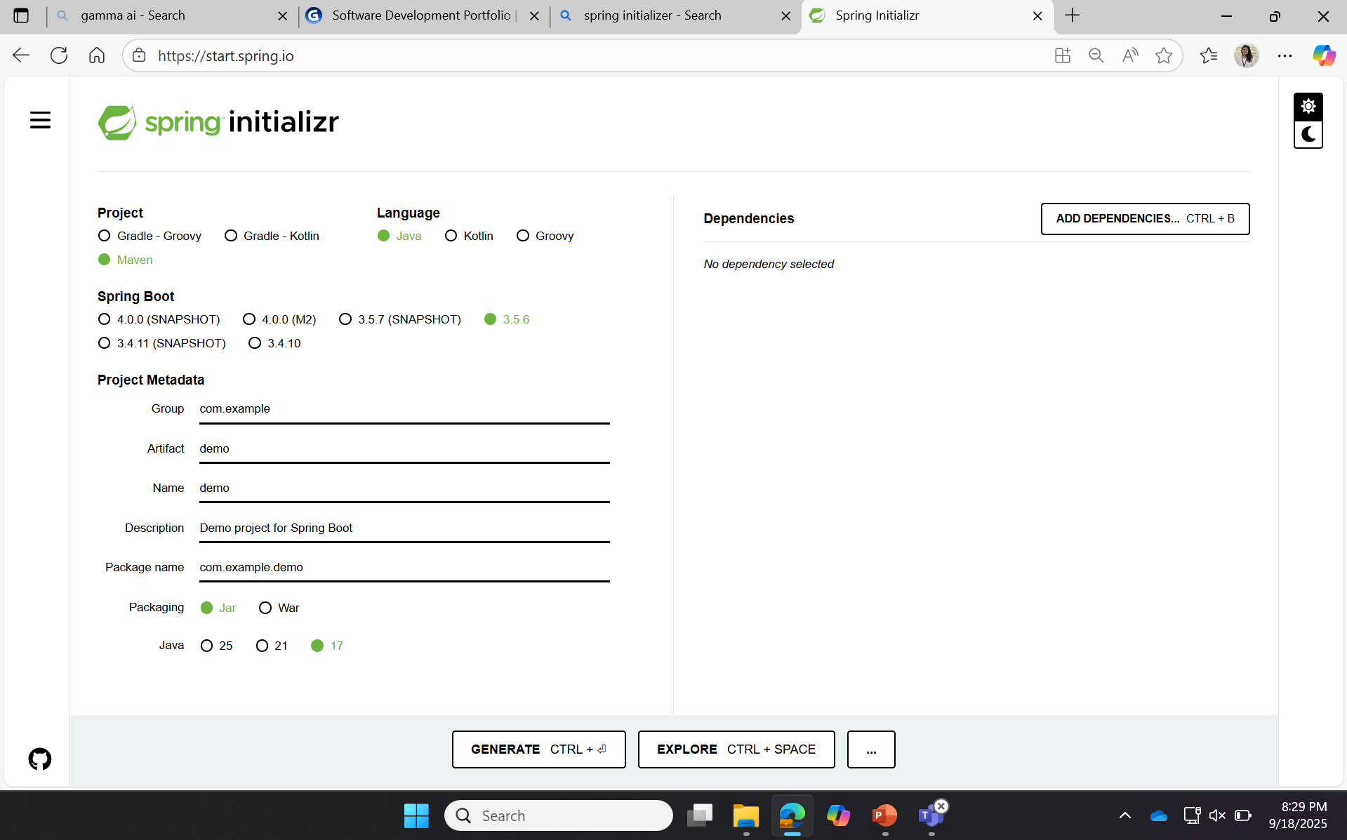

Slide 11
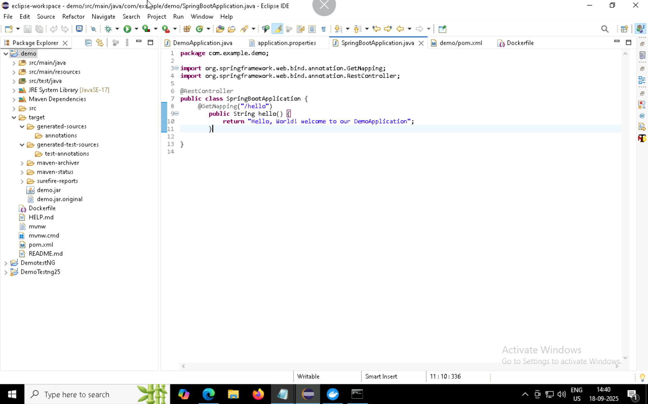
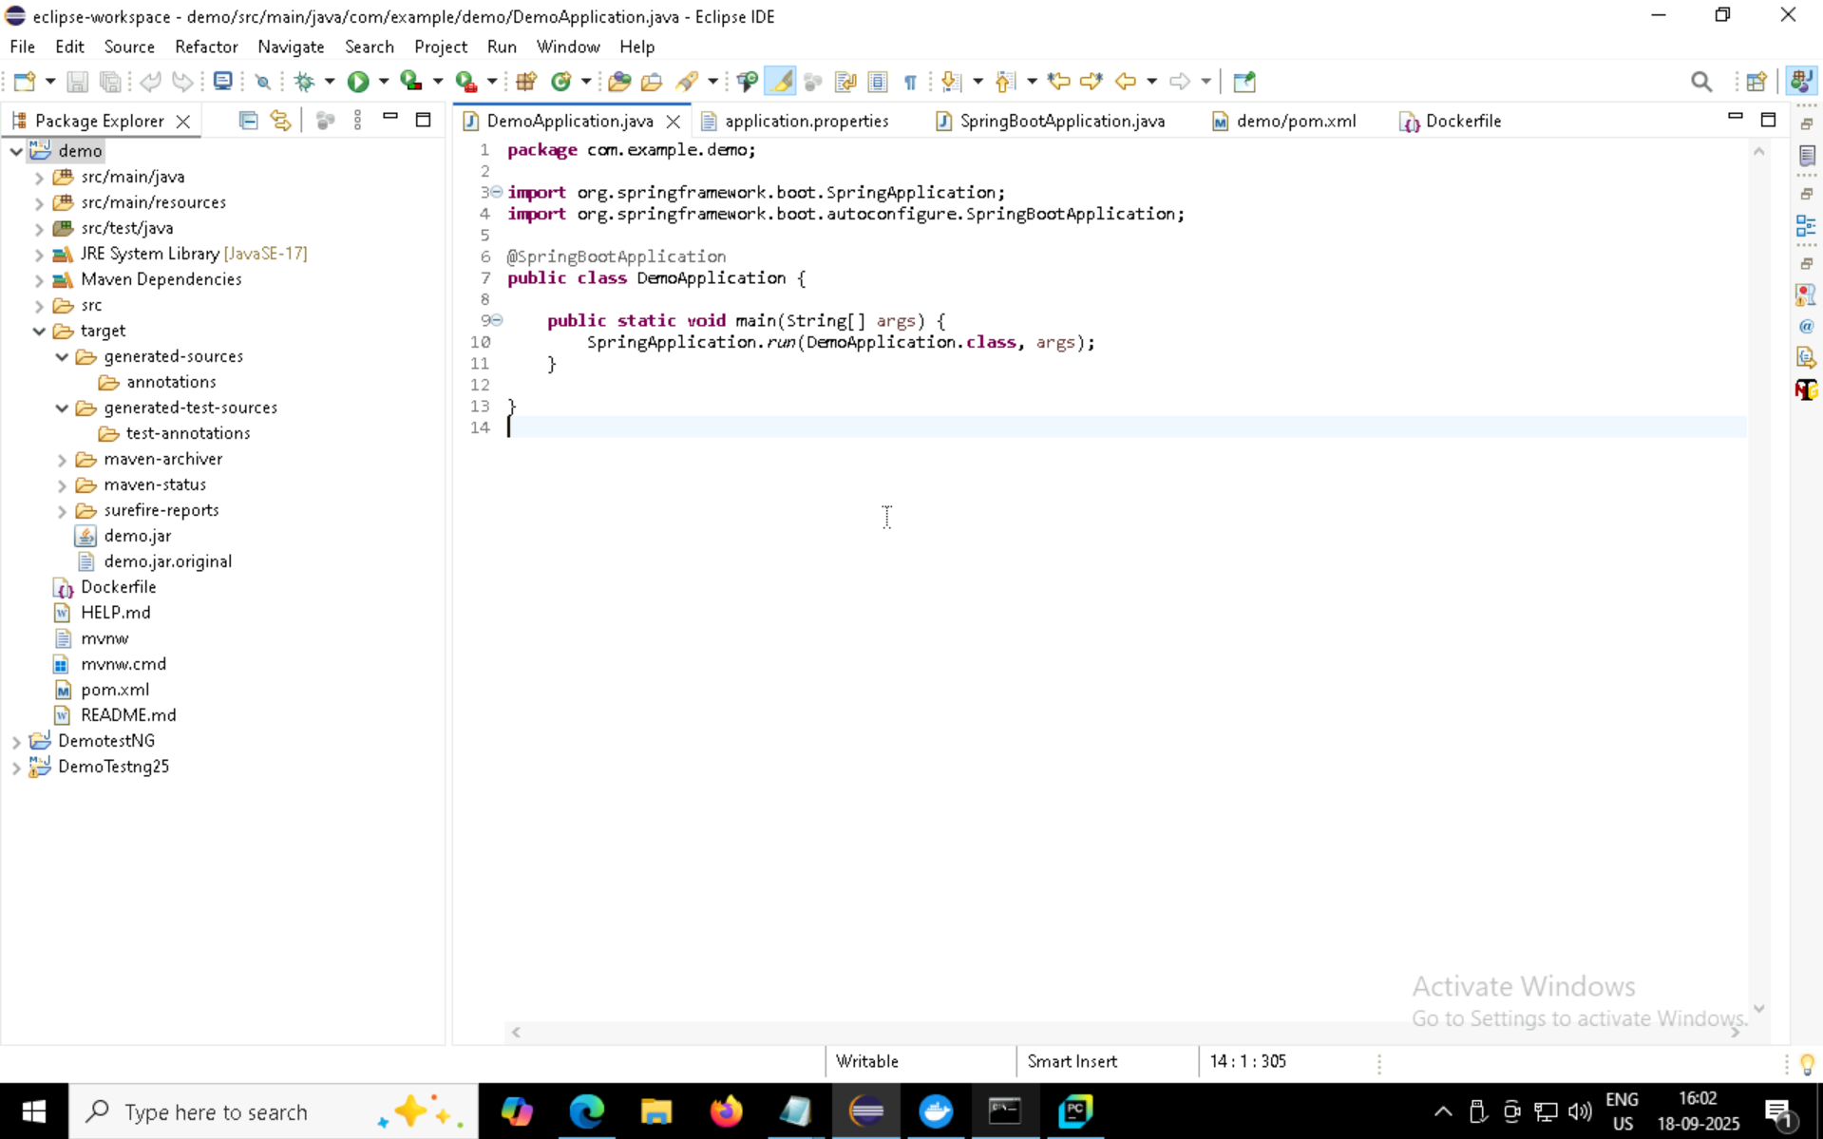

Slide 12
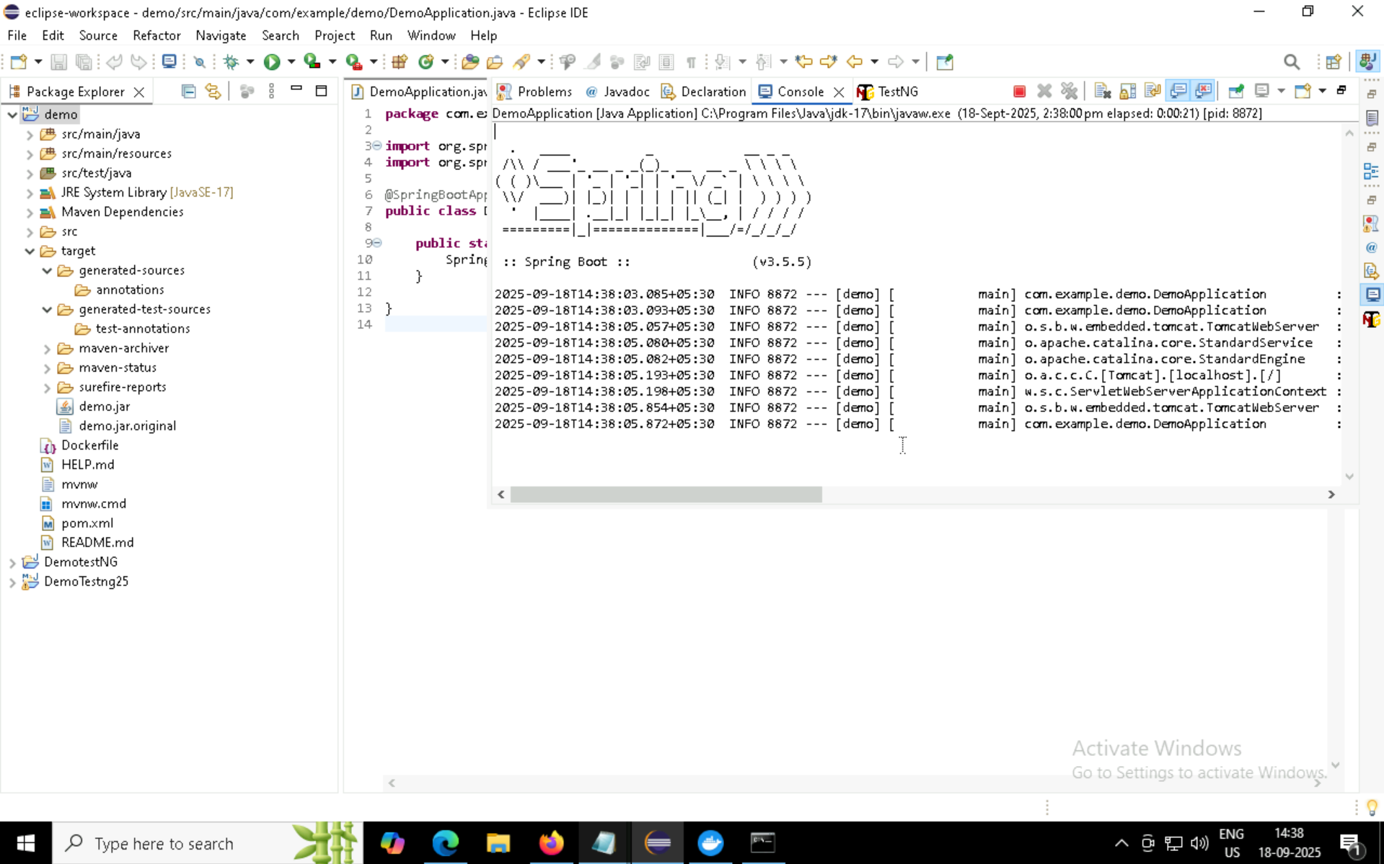
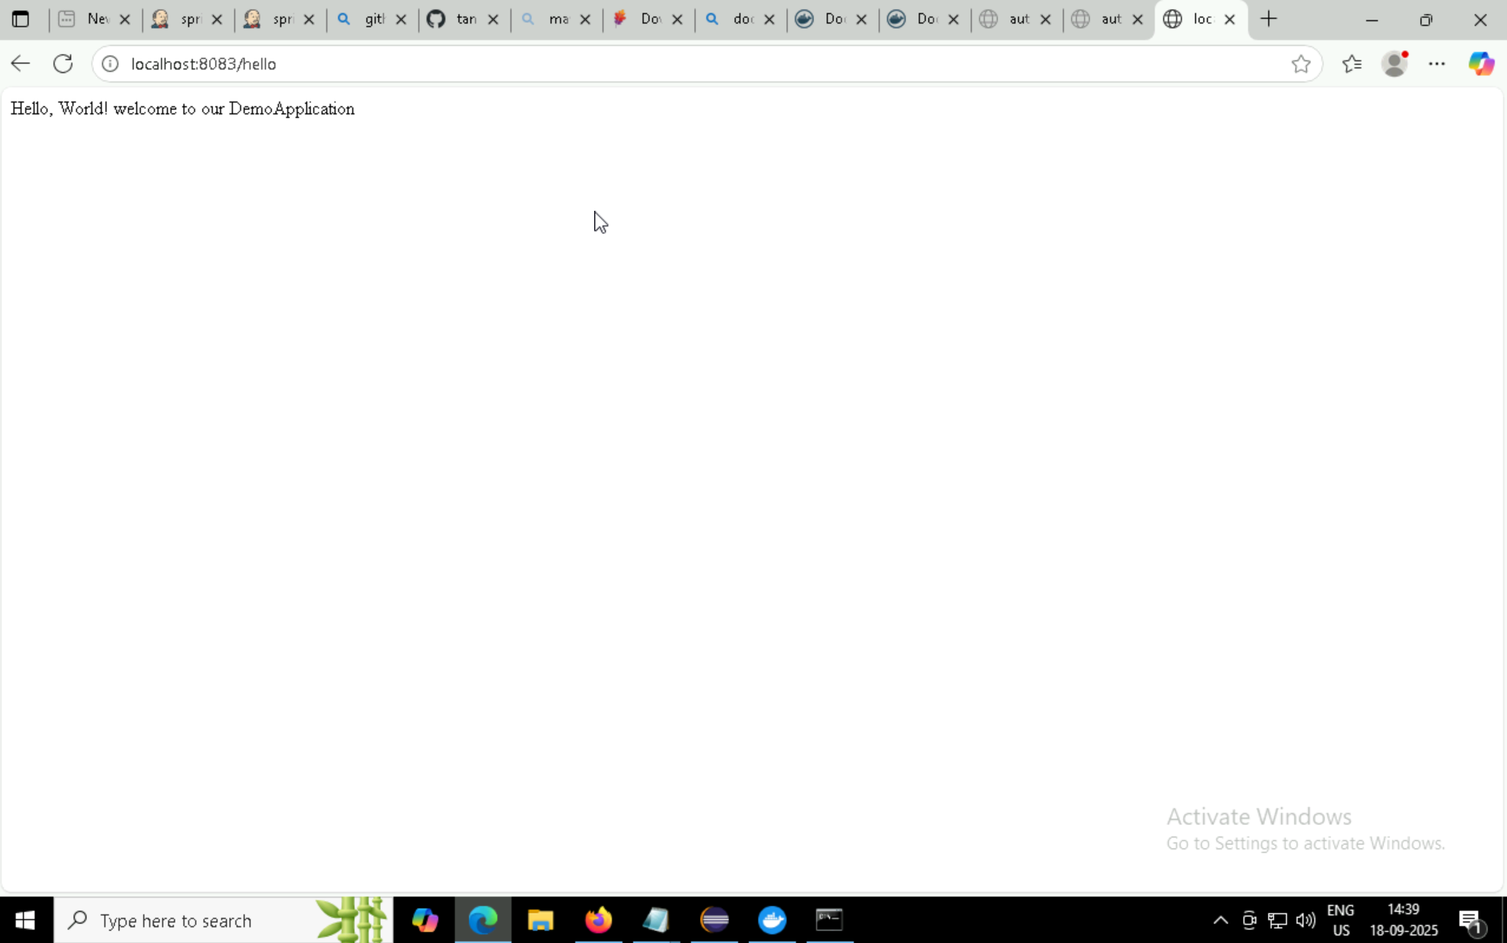

Slide 13
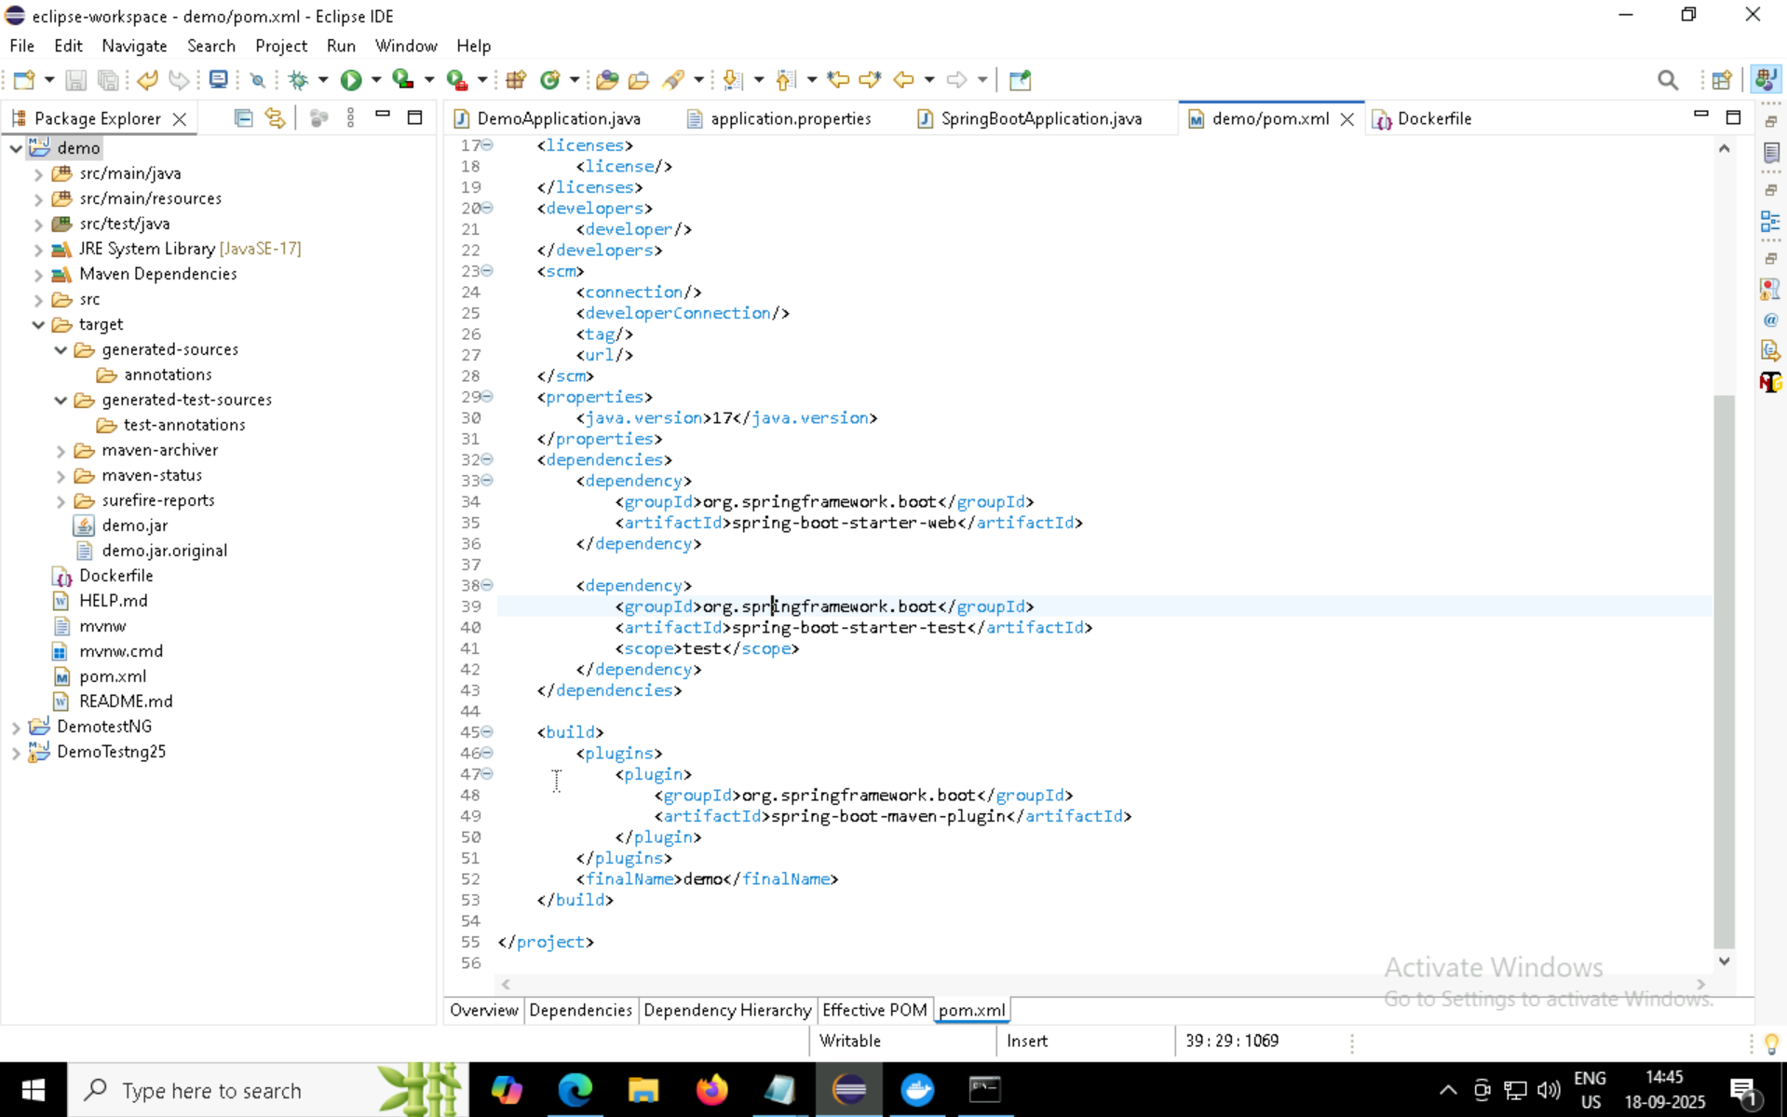
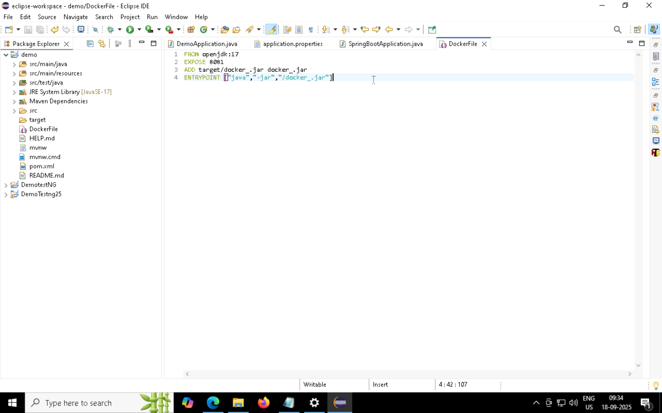

Slide 14
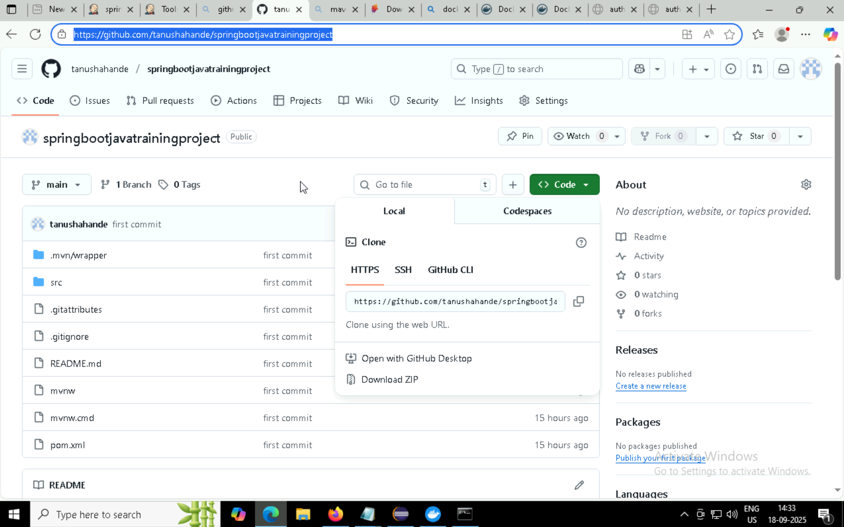
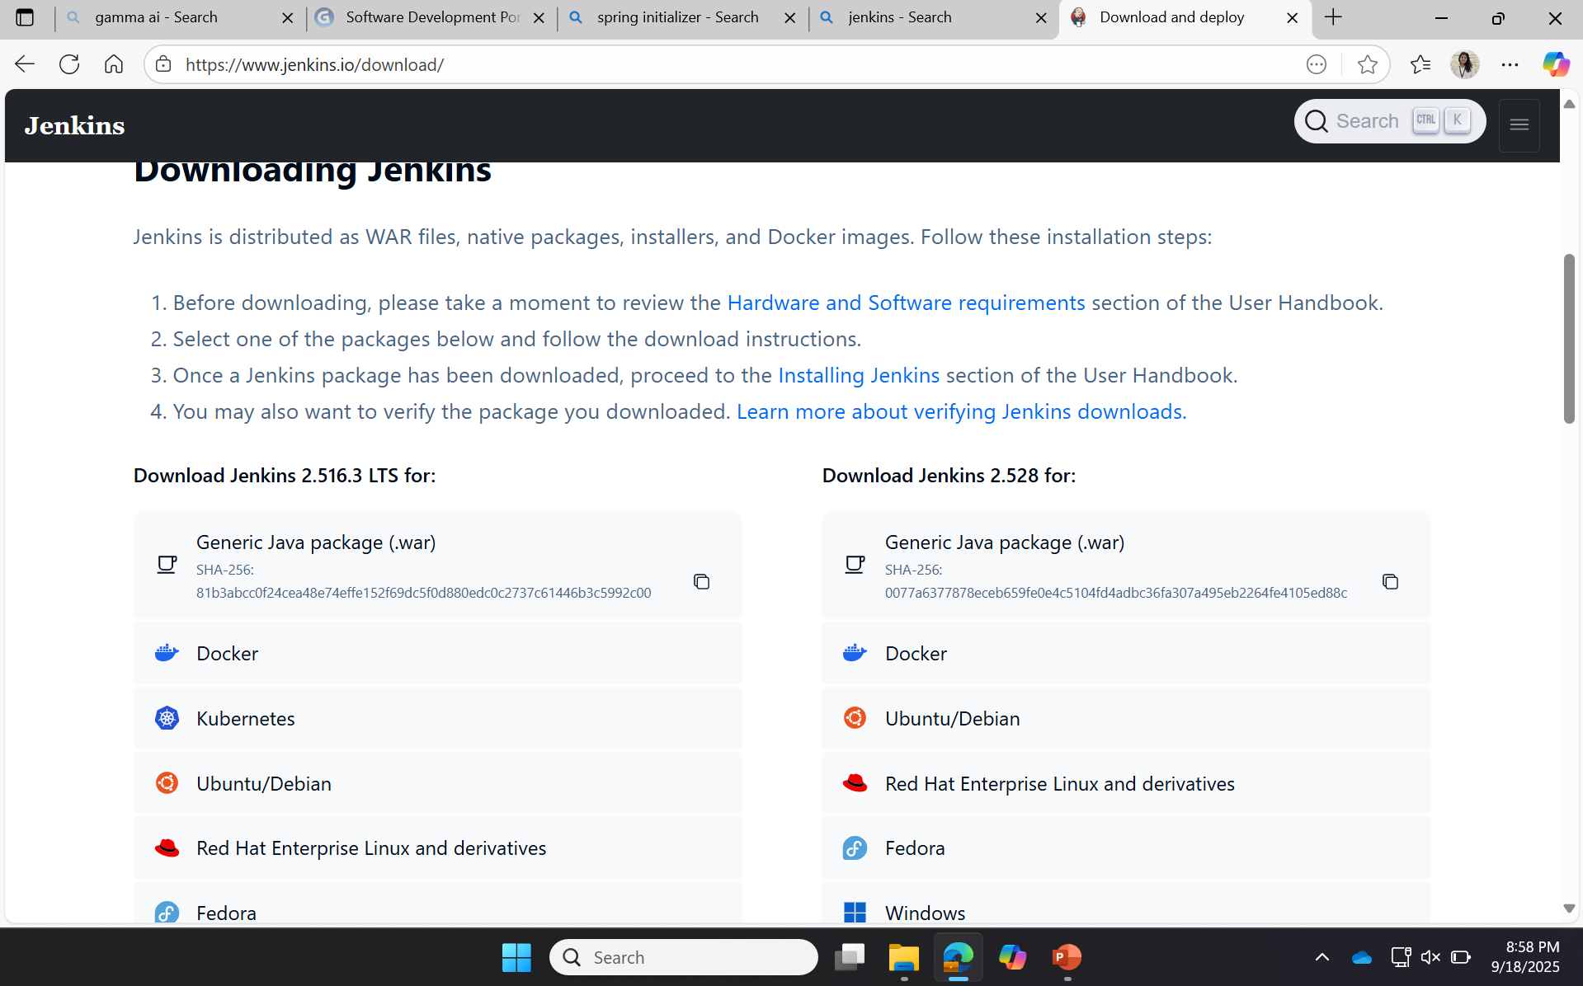

Slide 15
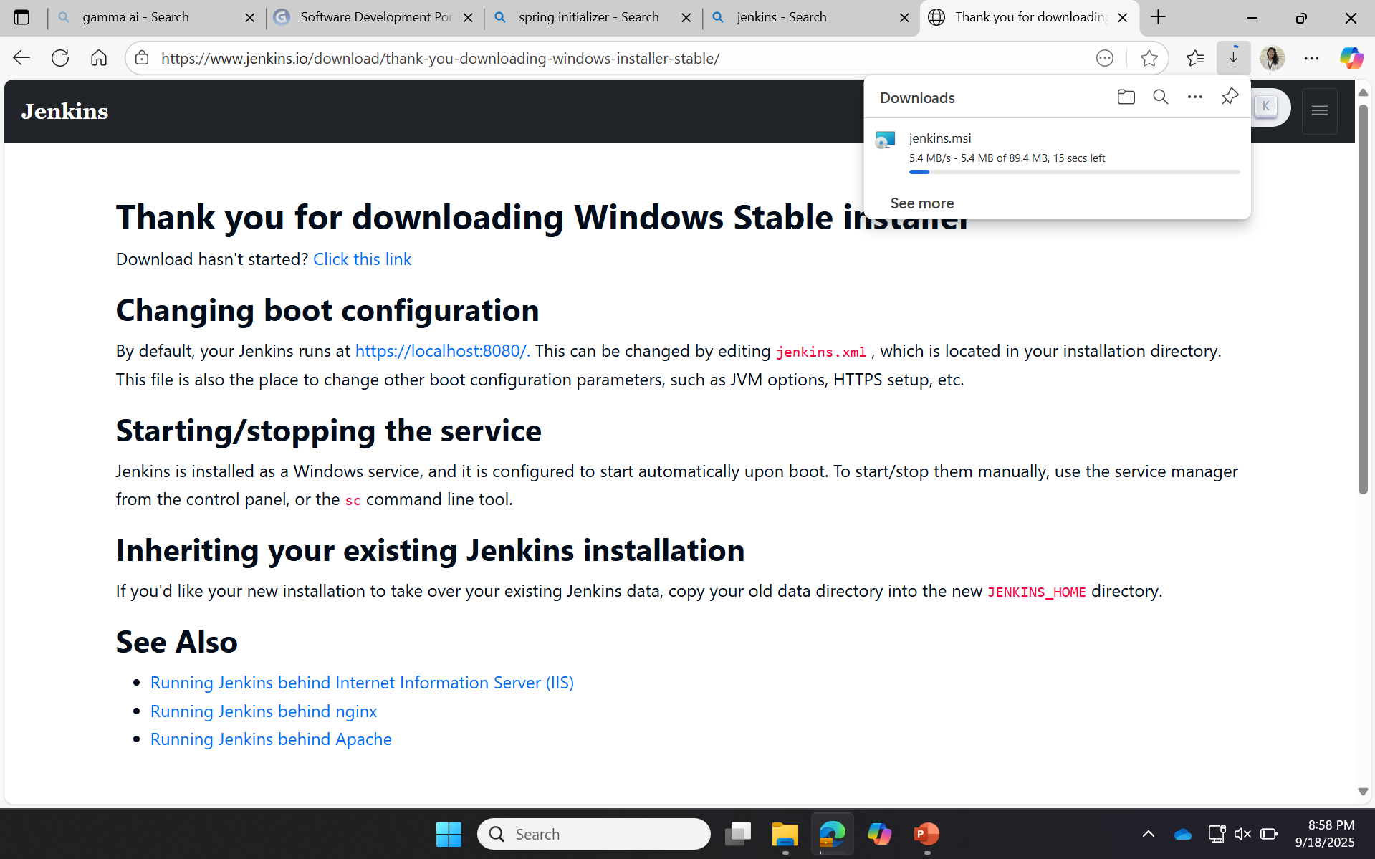
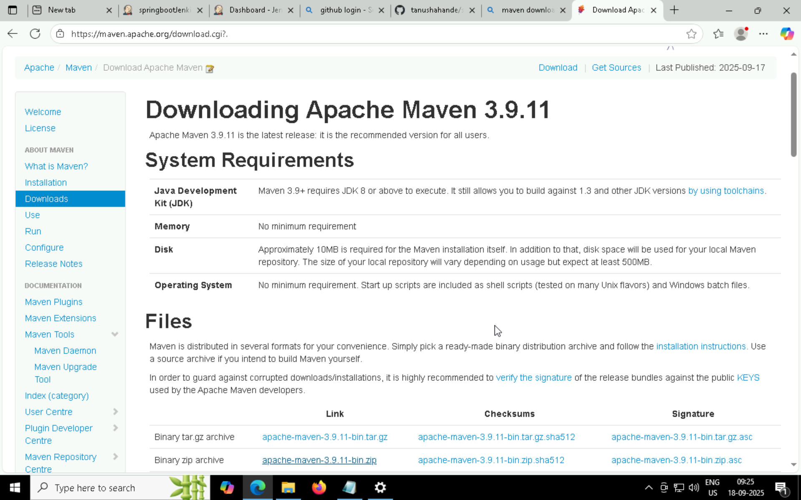

Slide 16
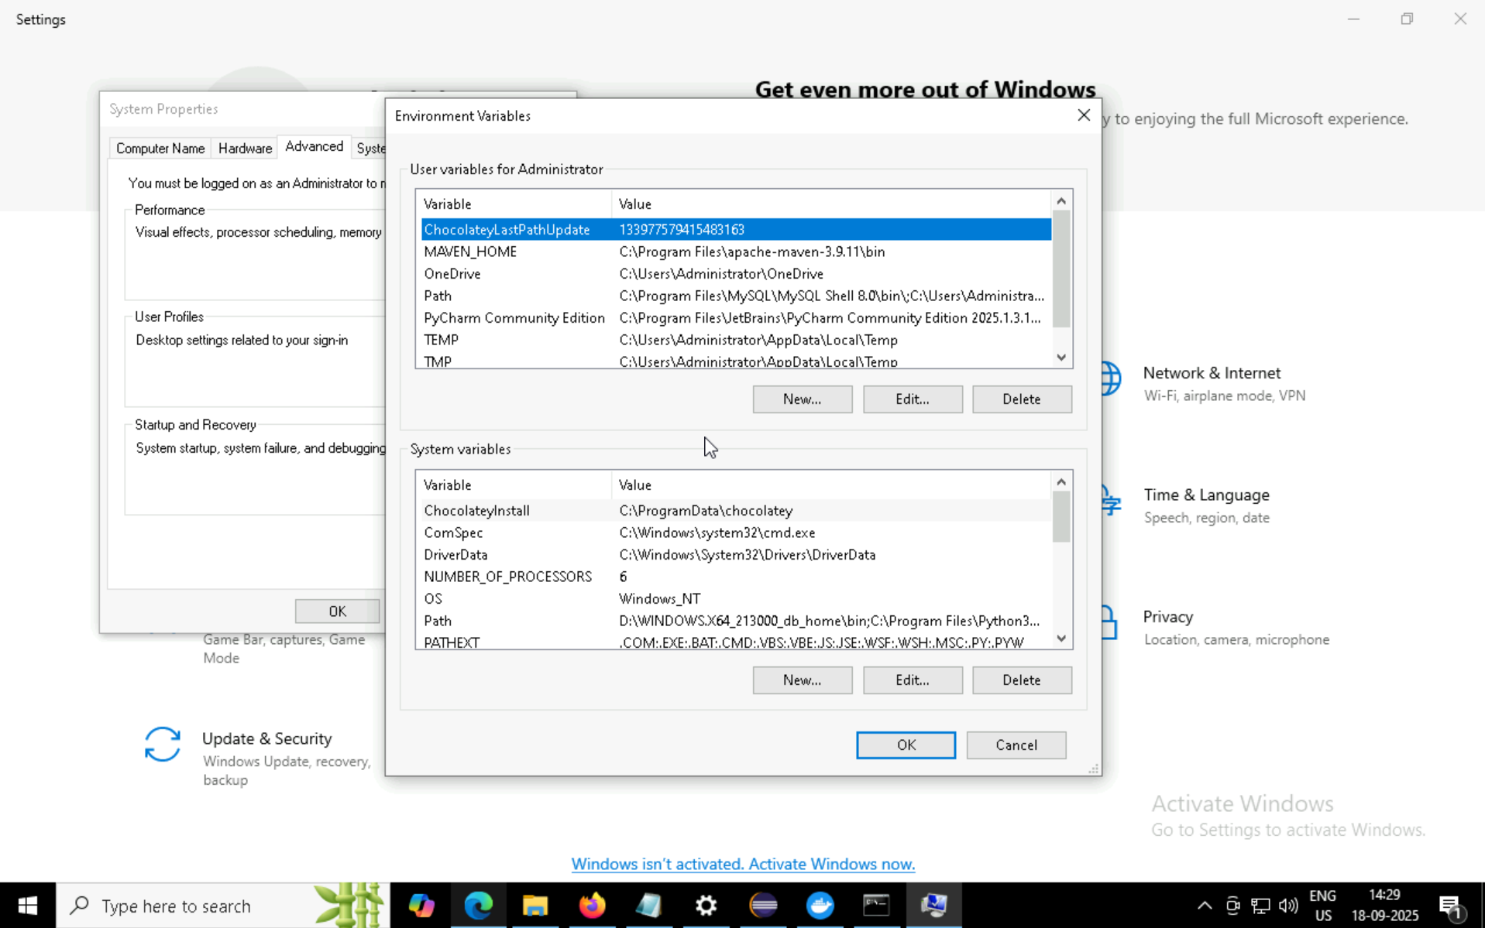
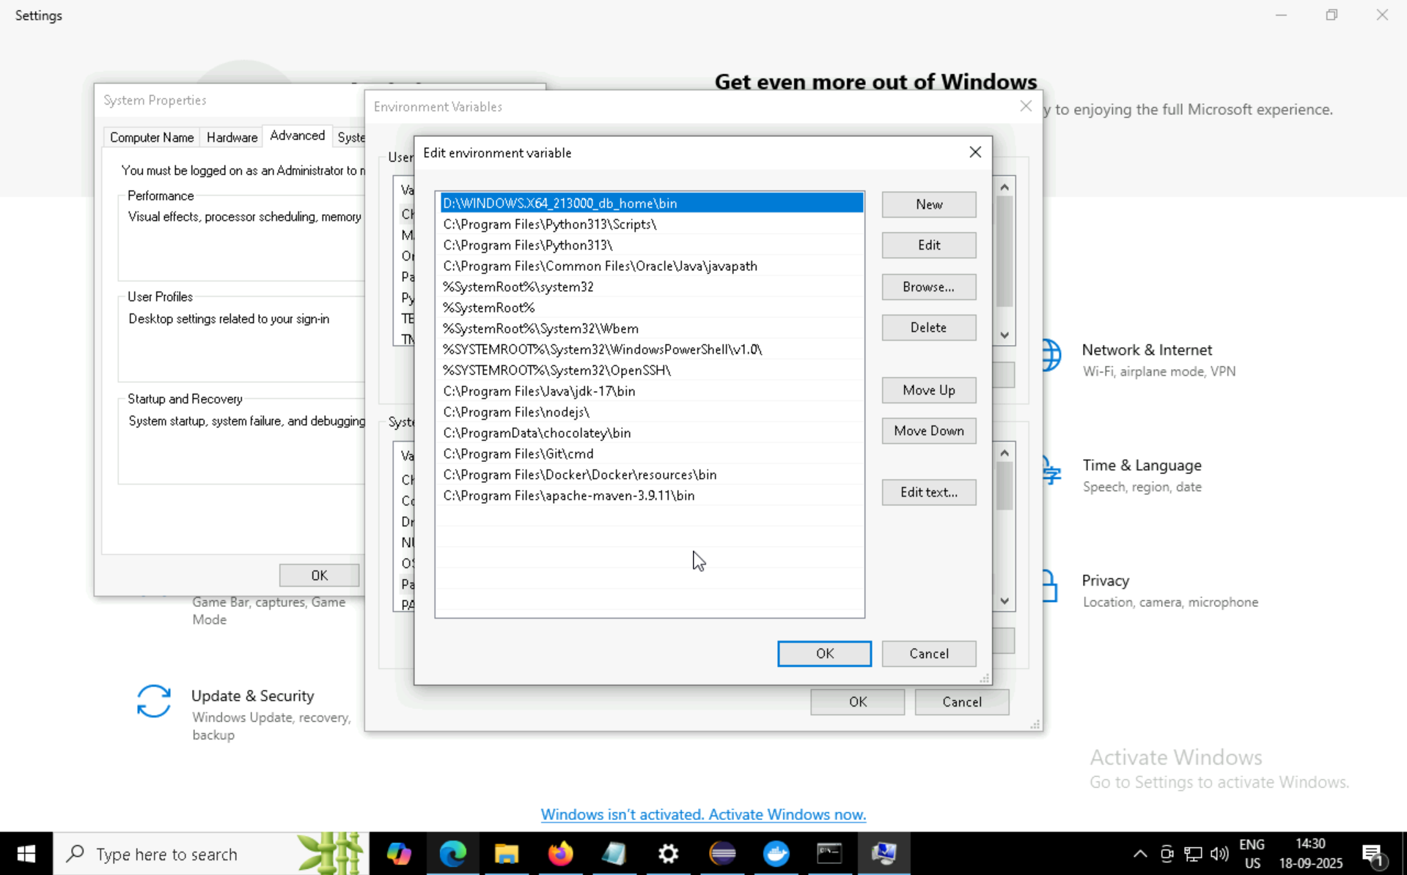

Slide 17
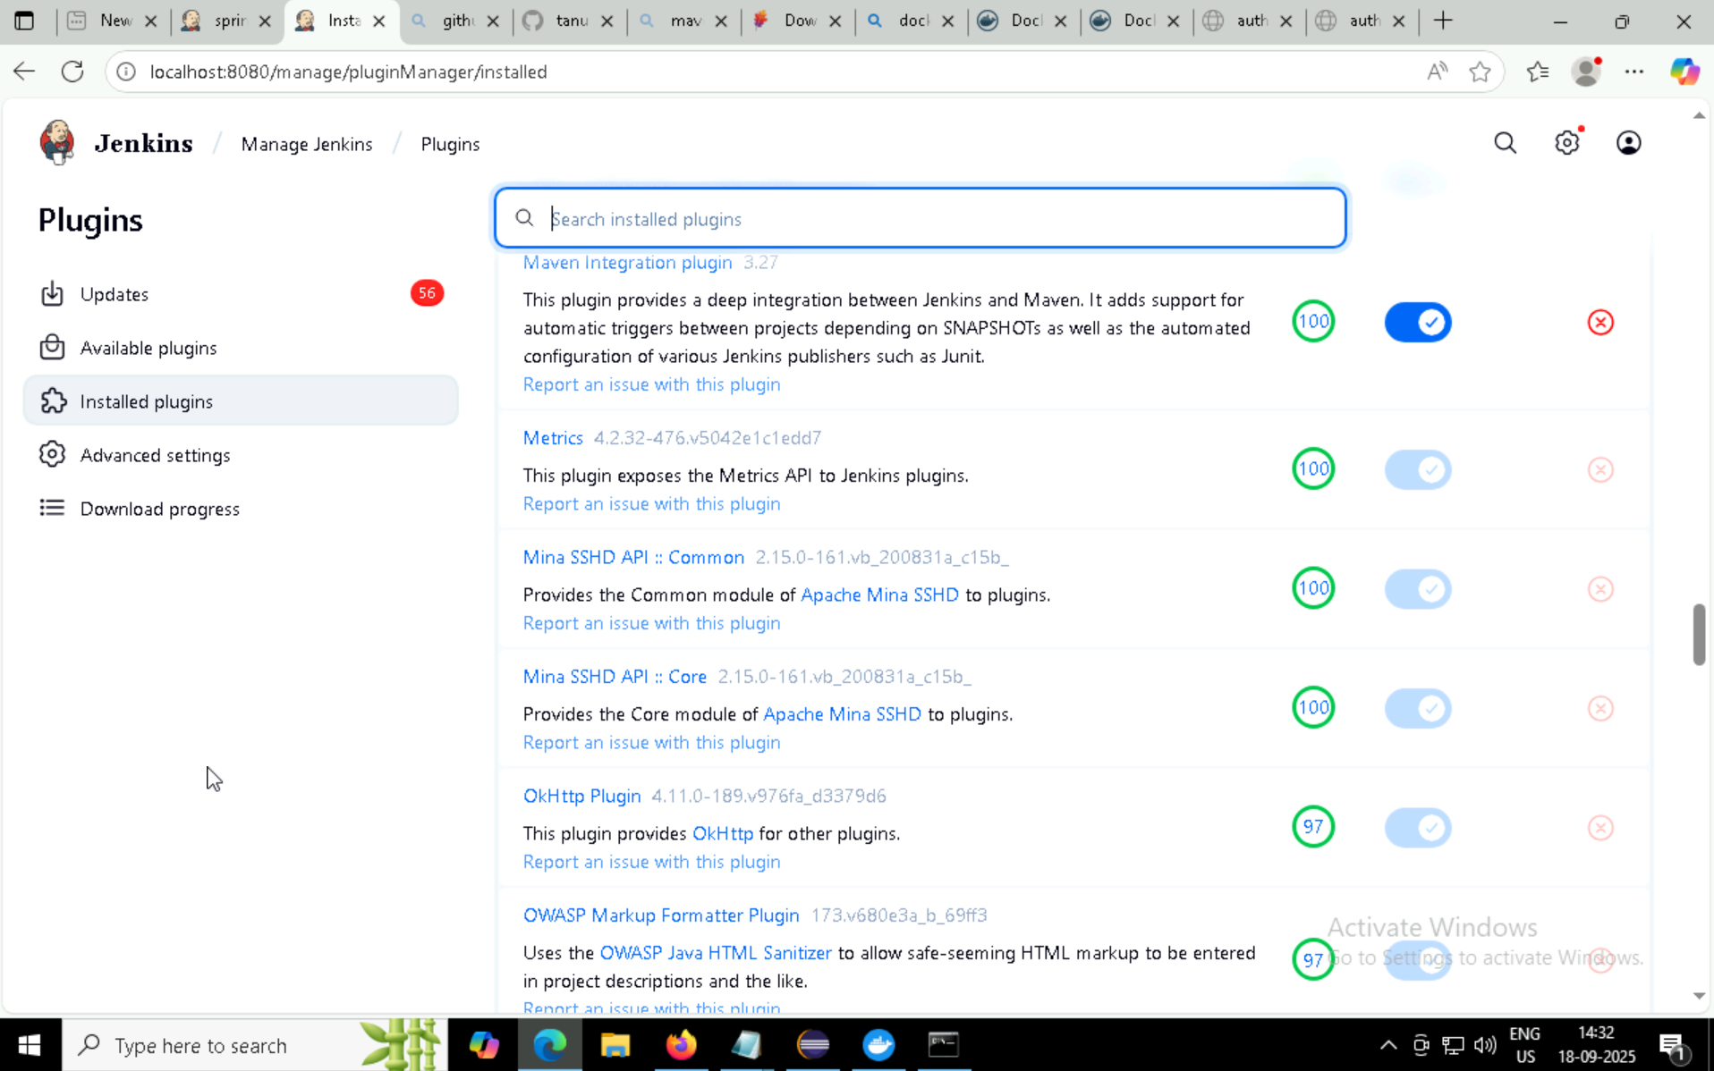
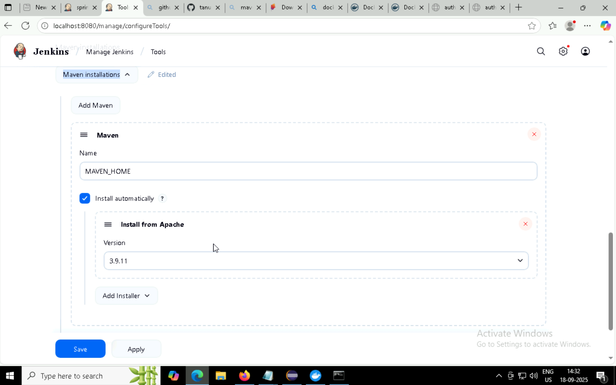

Slide 18
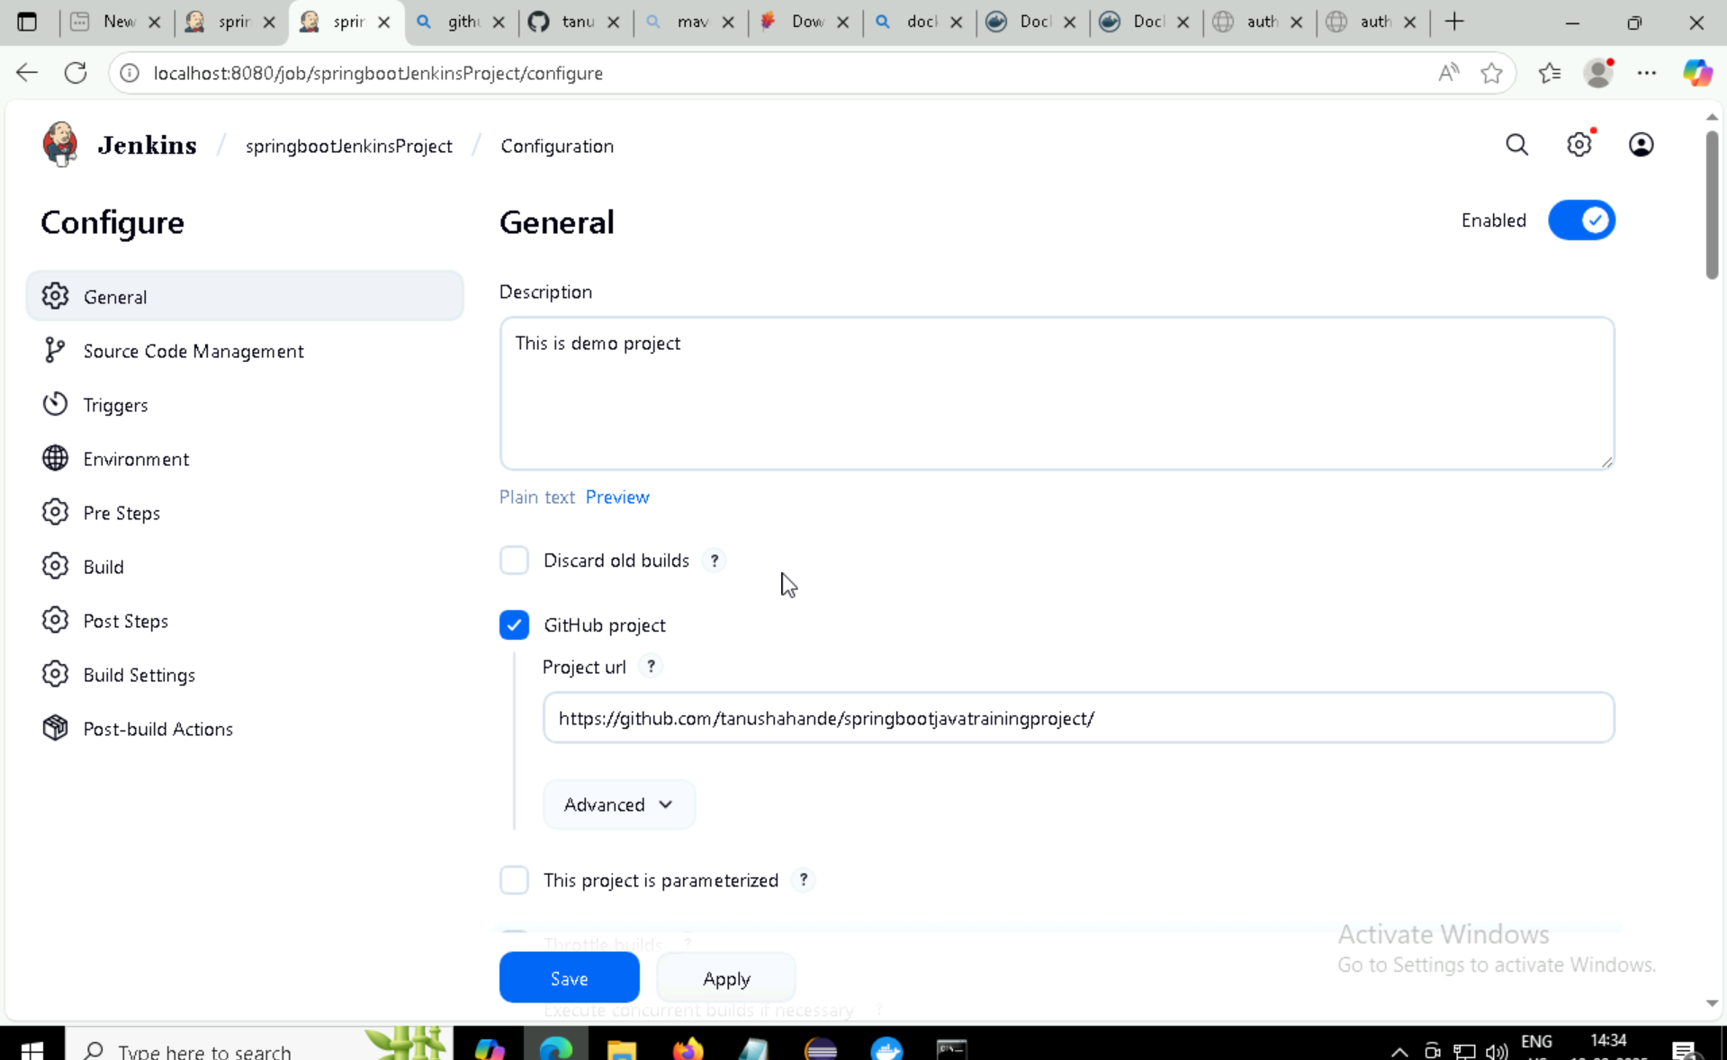
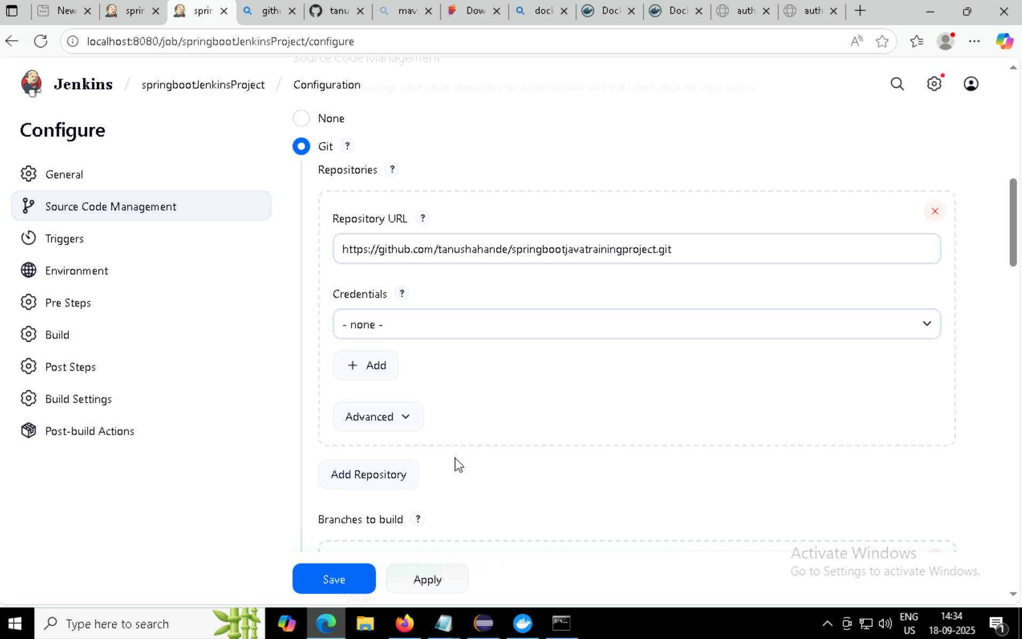

Slide 19
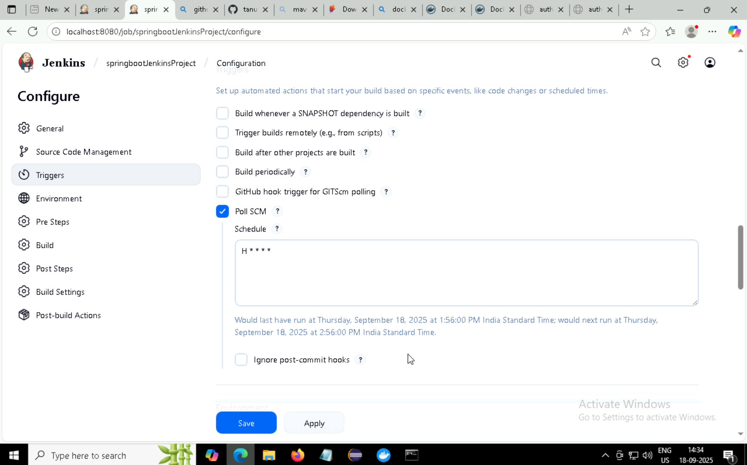
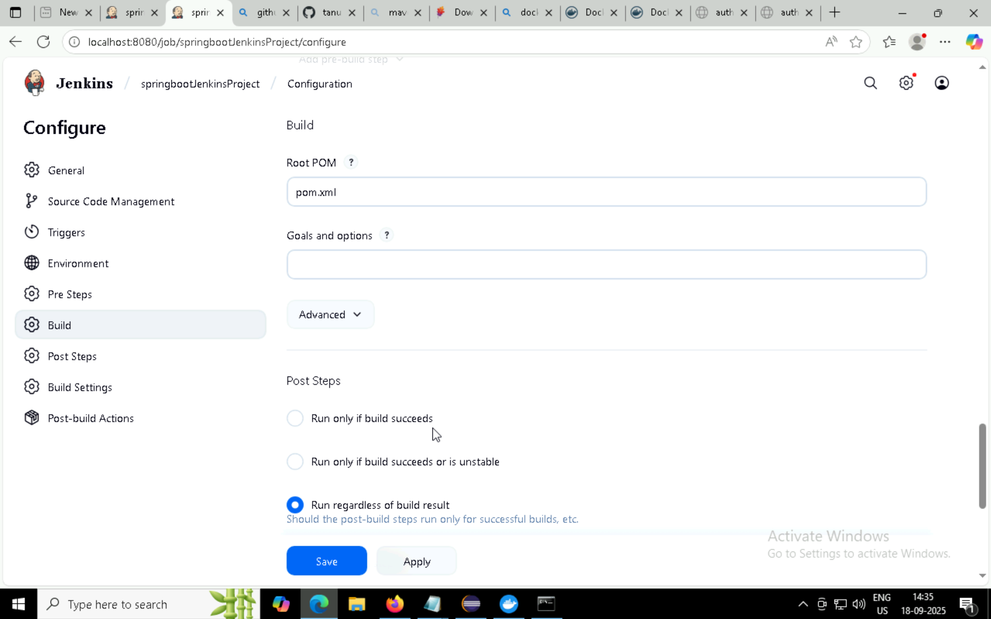

Slide 20
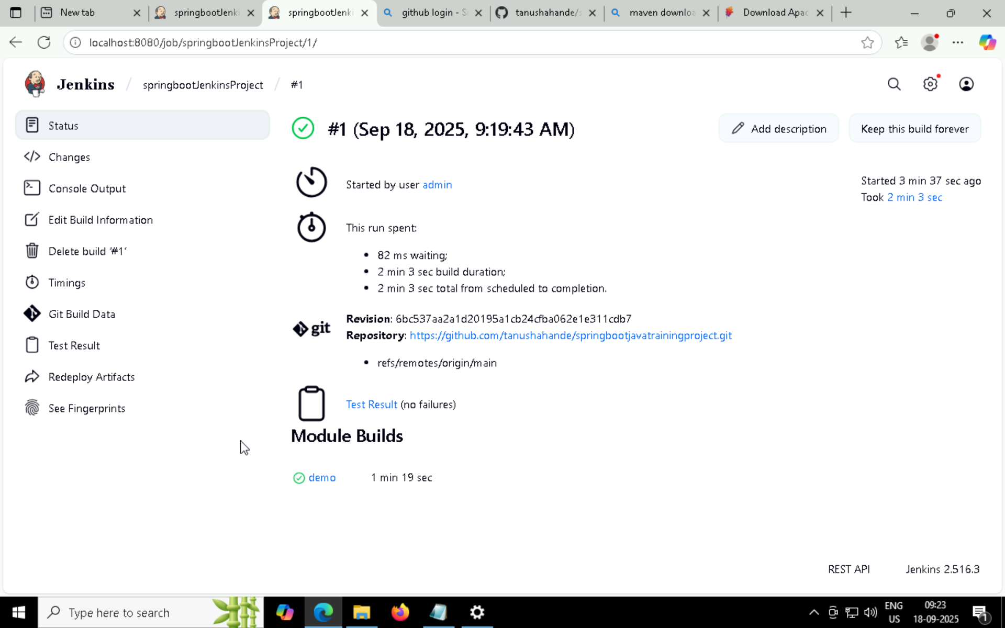

Slide 21
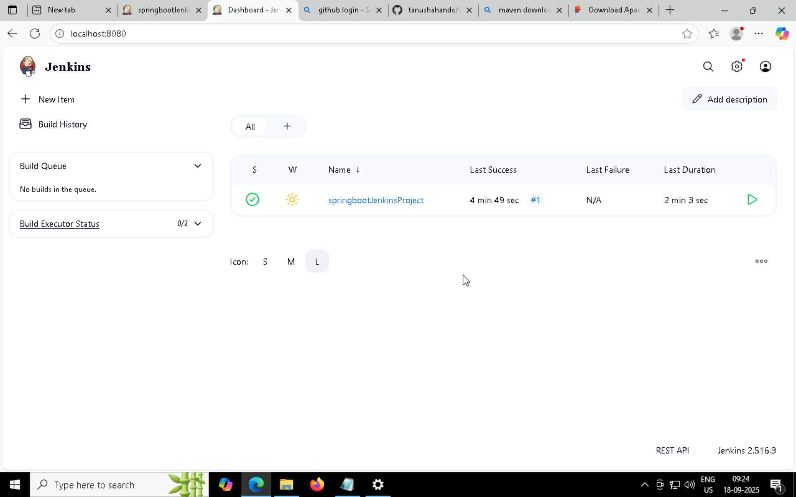
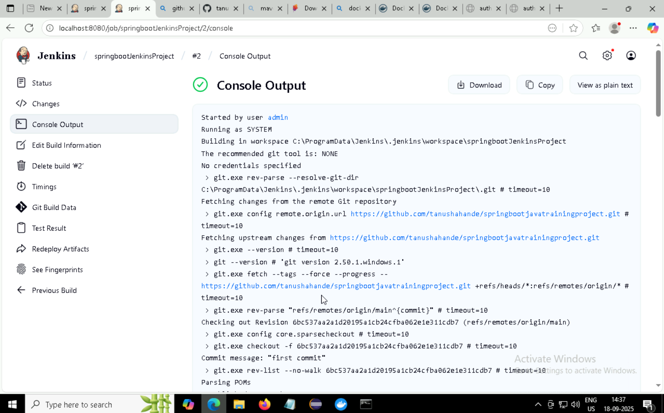

Slide 22
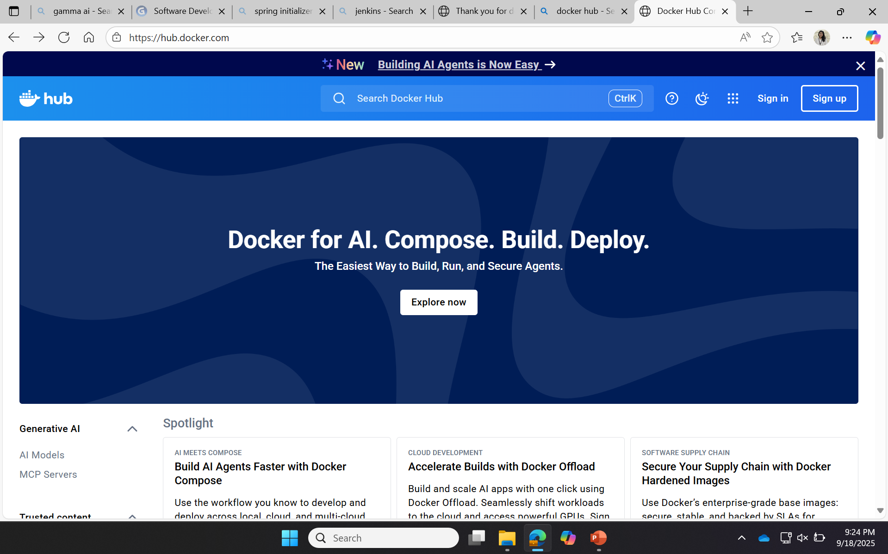
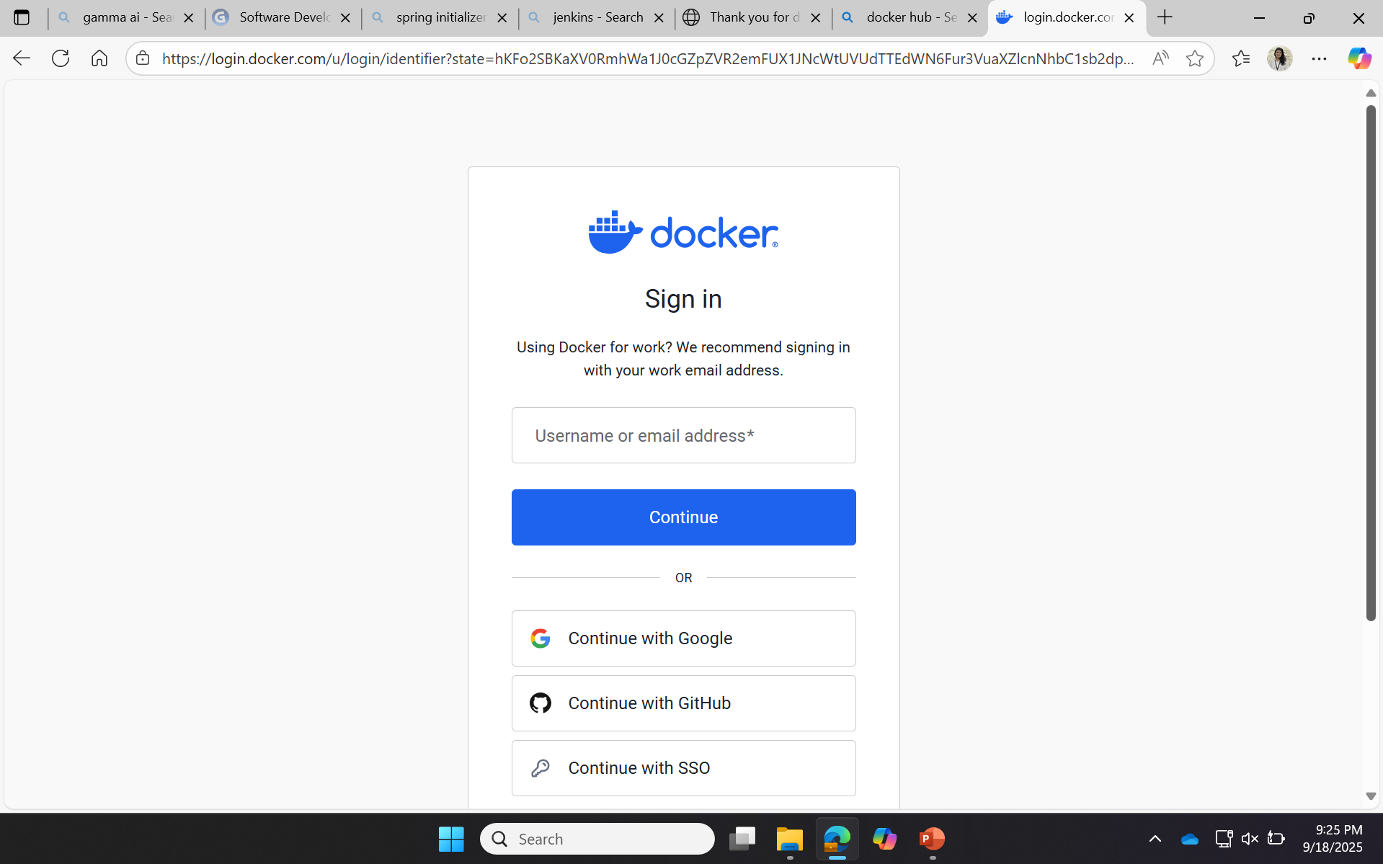

Slide 23
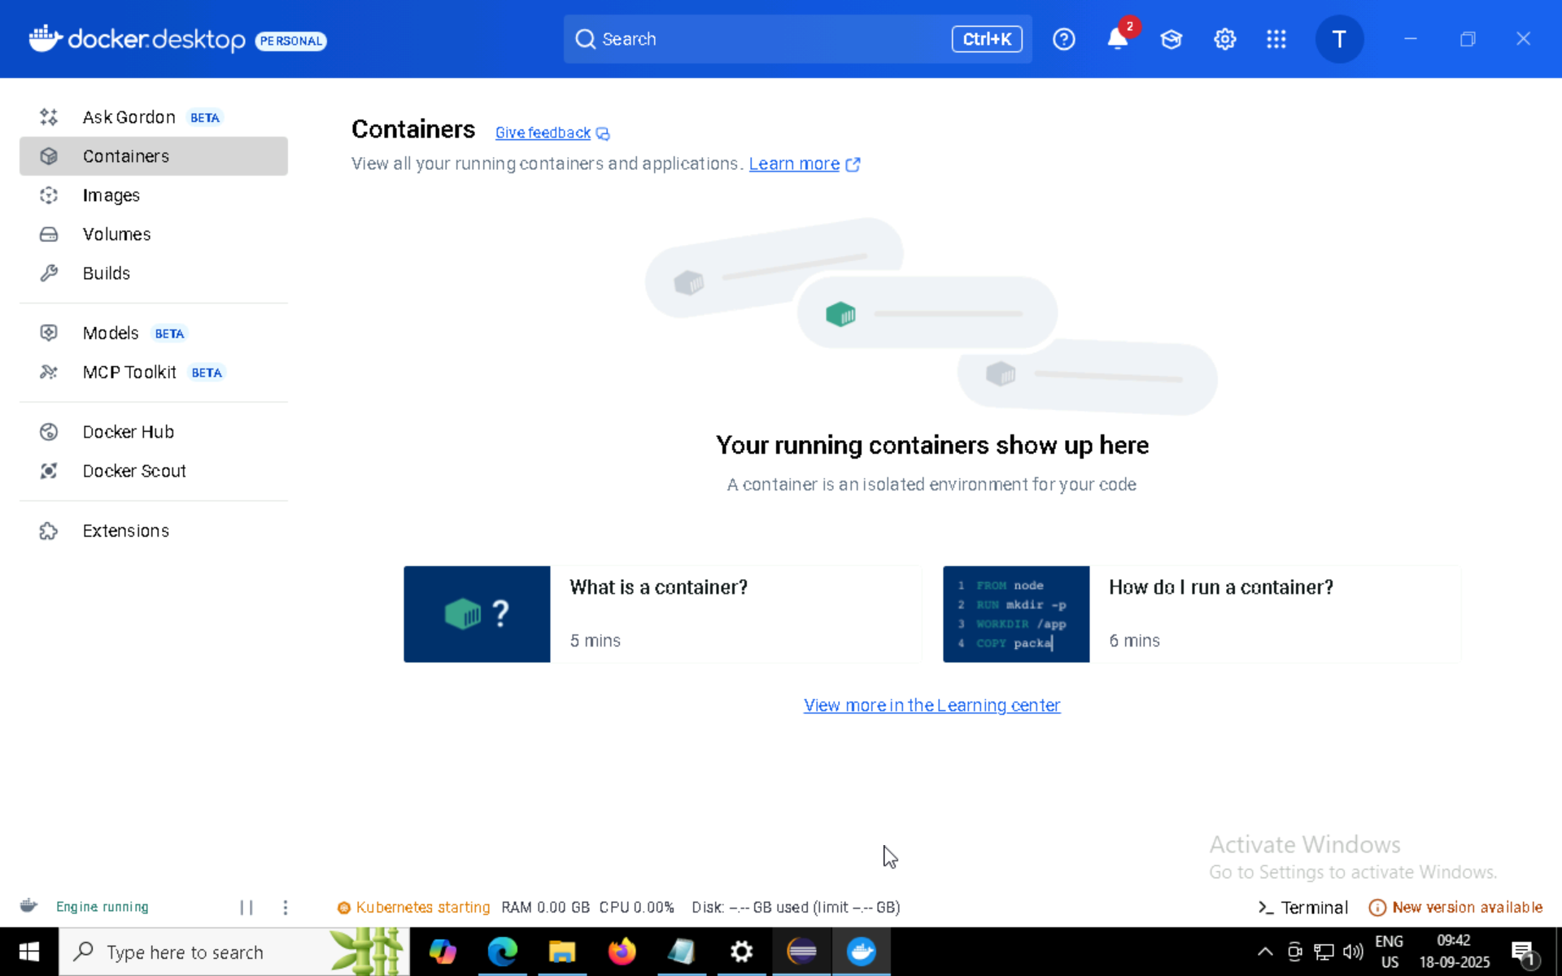
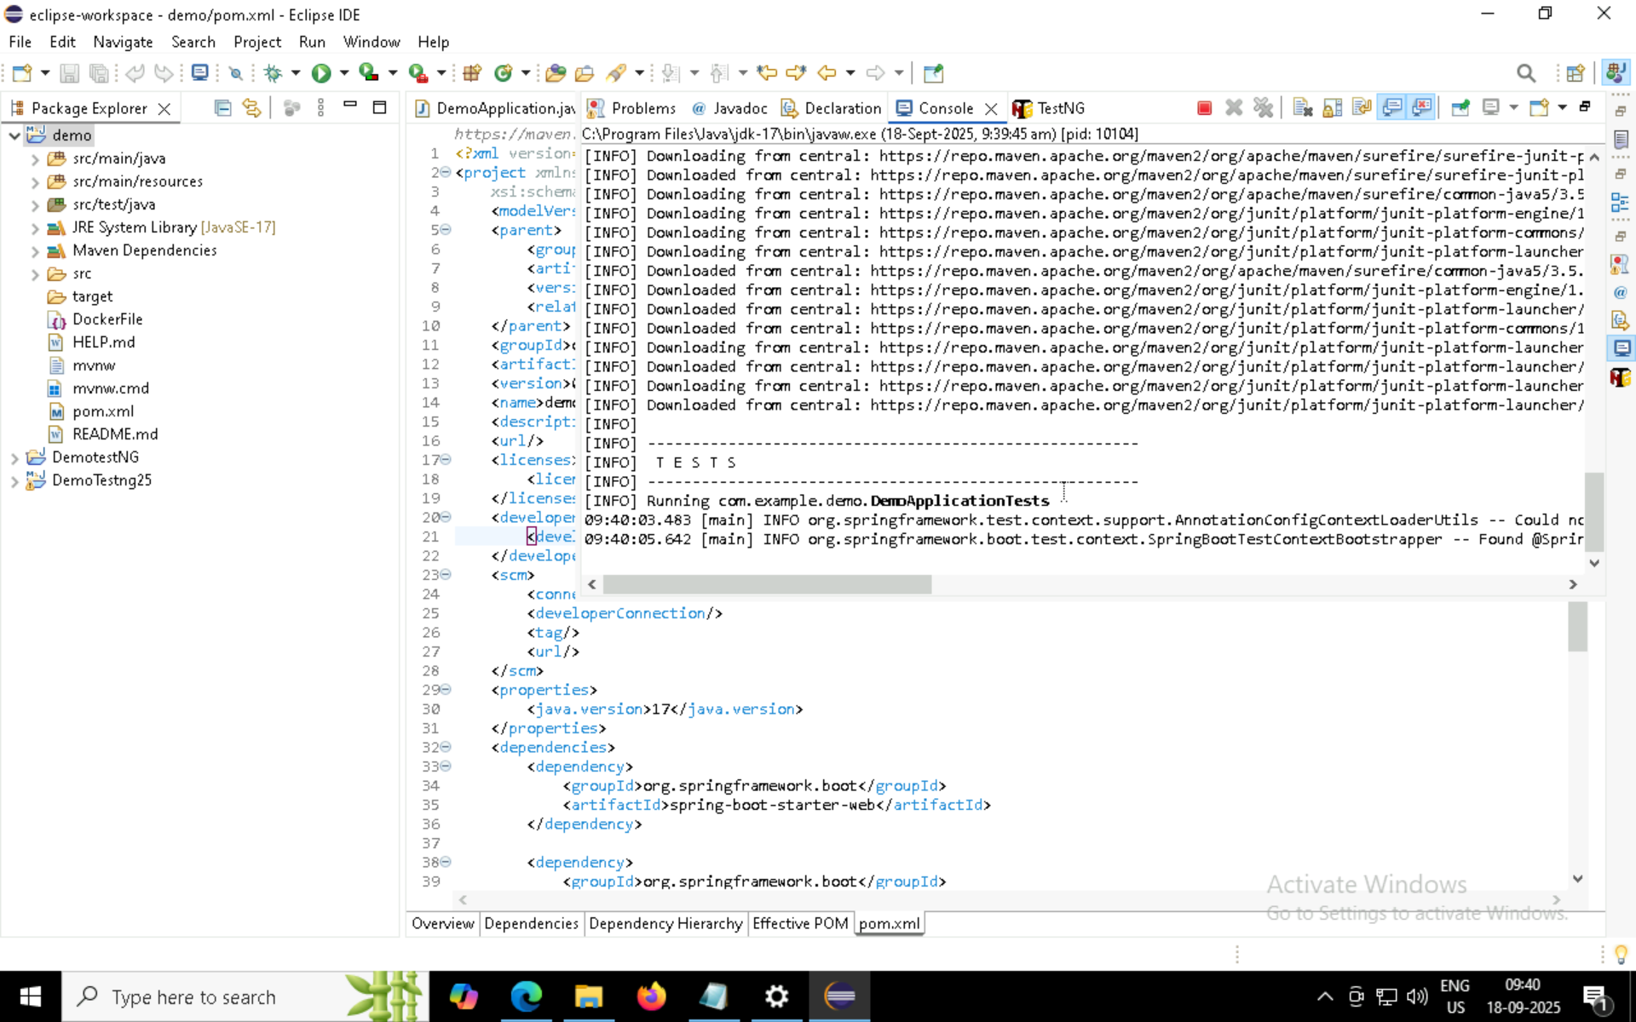

Slide 24
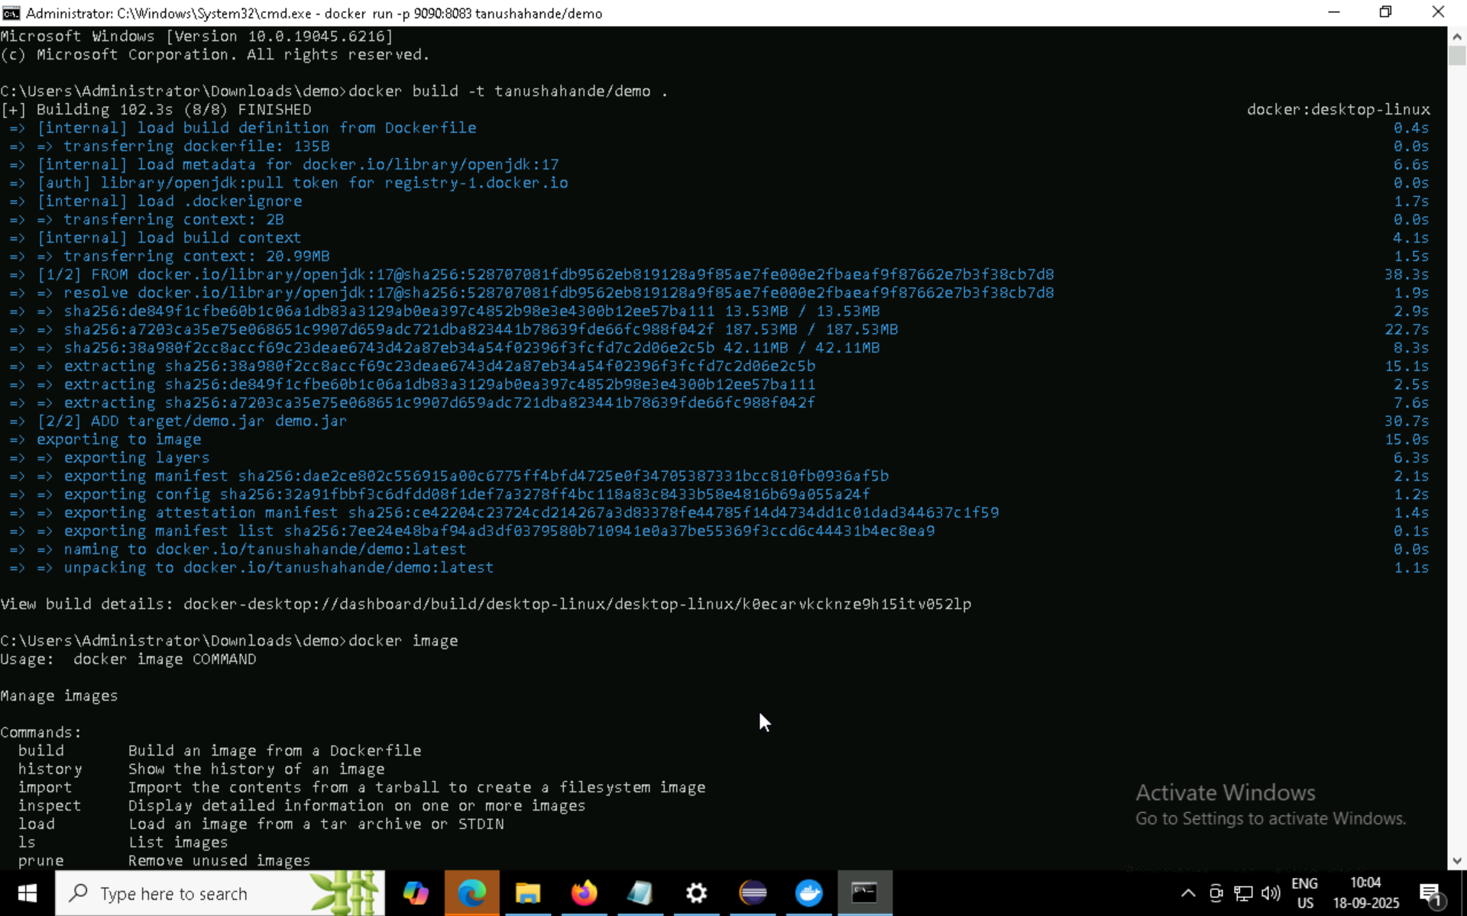
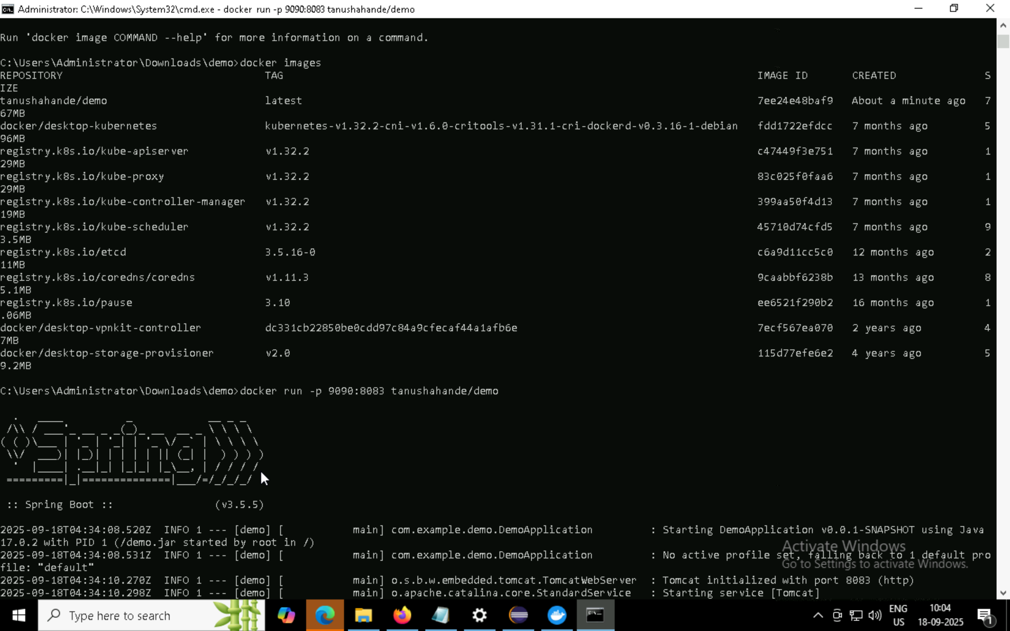

Slide 25
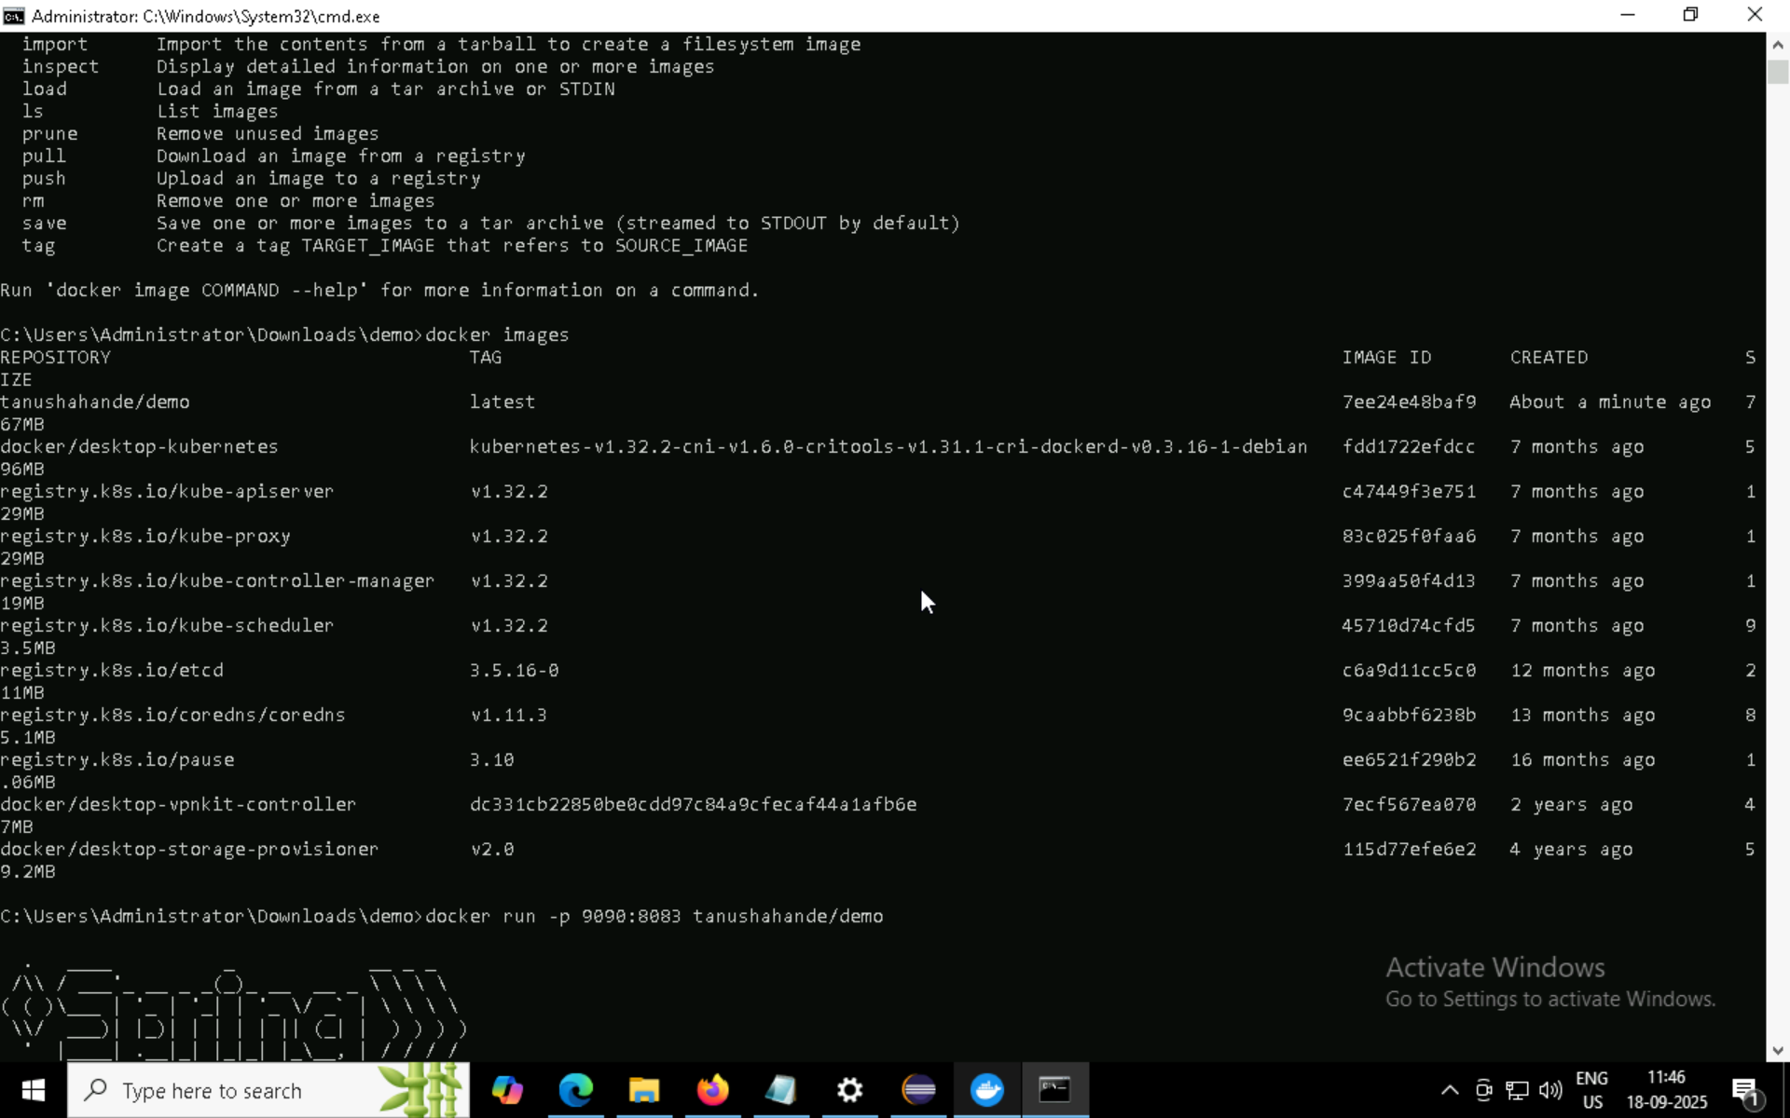
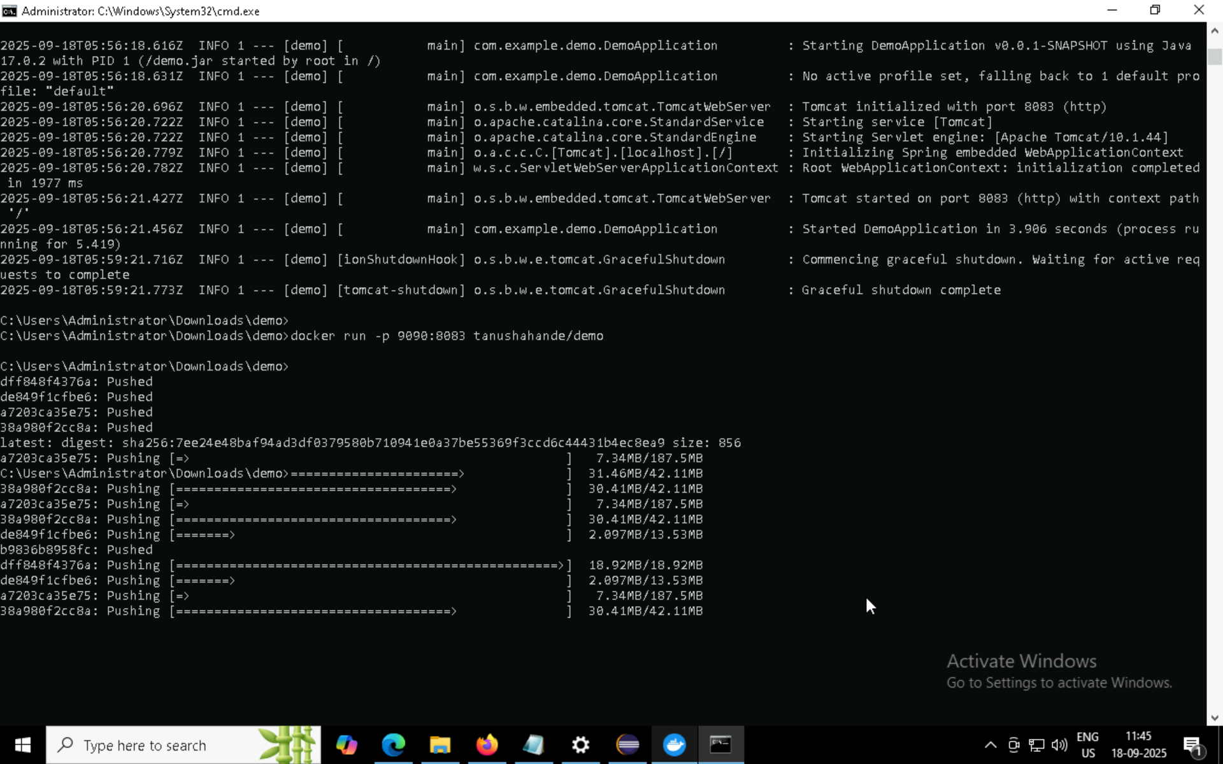

Slide 26
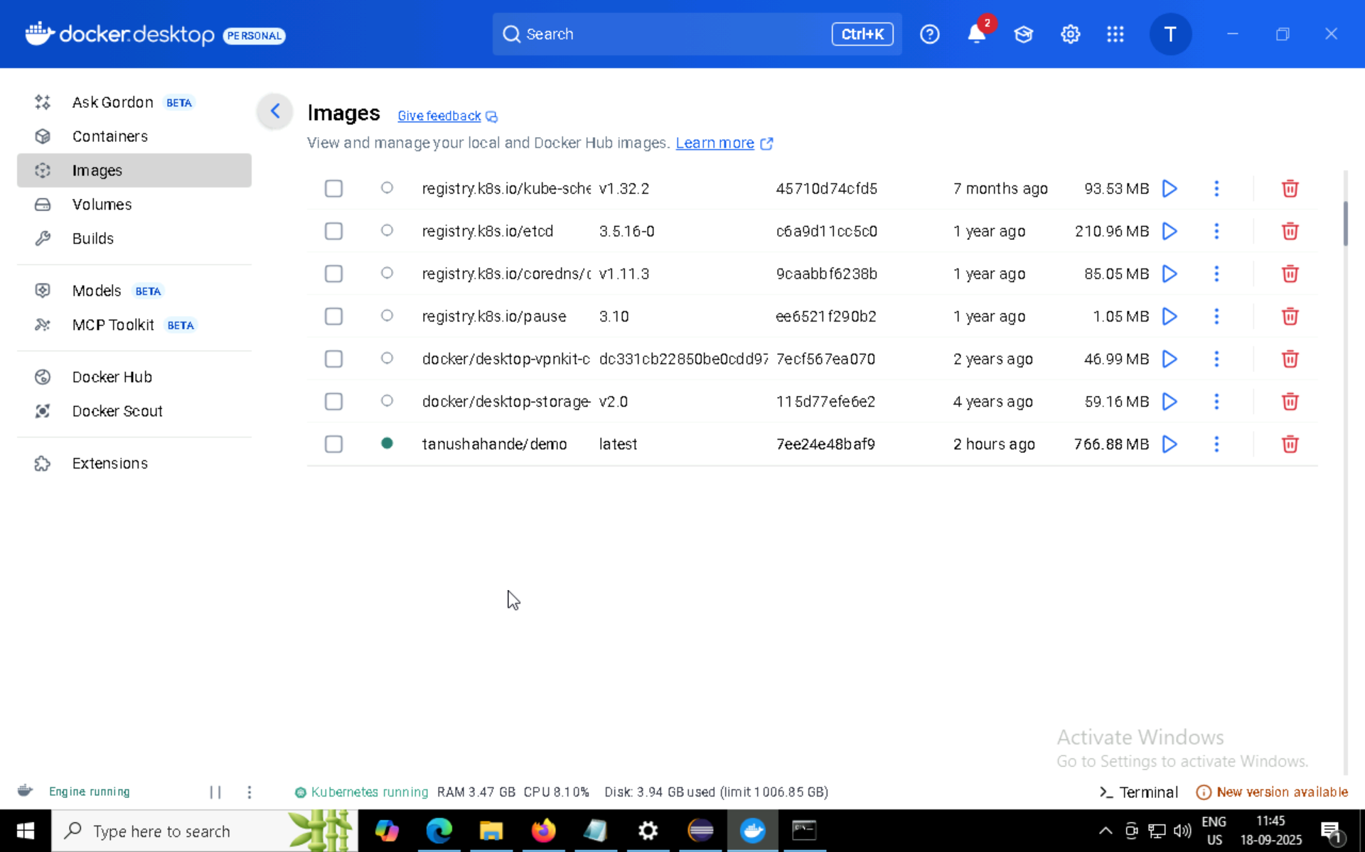
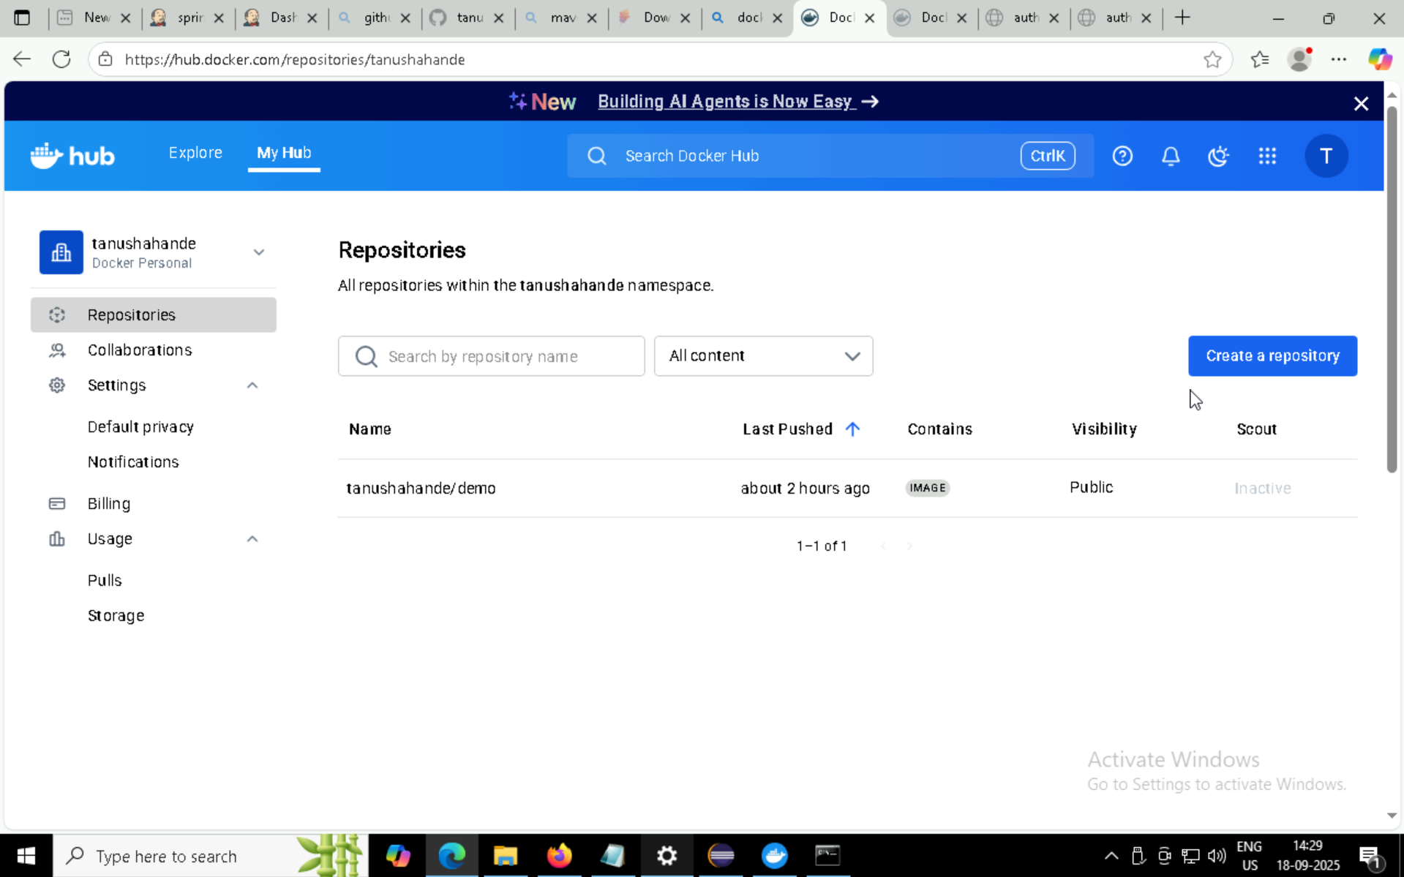

Slide 27

Technical Skills Demonstrated
Backend Development
DevOps & Tools
Python programming with SQLite
Version control with GitHub
Spring Boot framework mastery
CI/CD pipeline with Jenkins
Database design and operations
Docker containerization
Automated deployment strategies

Slide 28
Project Impact & Learning
Course Management System
DevOps Pipeline
Gained expertise in database operations, Python development, and user interface design. Demonstrated ability to create functional educational software solutions.
Mastered modern deployment practices, containerization, and continuous integration. Built foundation for scalable application architecture.

Slide 29

Conclusion
These projects showcase a comprehensive understanding of both traditional software development and modern DevOps practices.
From database management to containerized deployments, this portfolio demonstrates readiness for full-stack development roles in today's technology landscape.
Ready to contribute to innovative software solutions!

